Slide 1
ARCHITECTURE / ENGINEERING / INTERIORS
ATF MEETING #1 PLYMOUTH PUBLIC LIBRARY
PUBLIC PLANNING

Slide 2
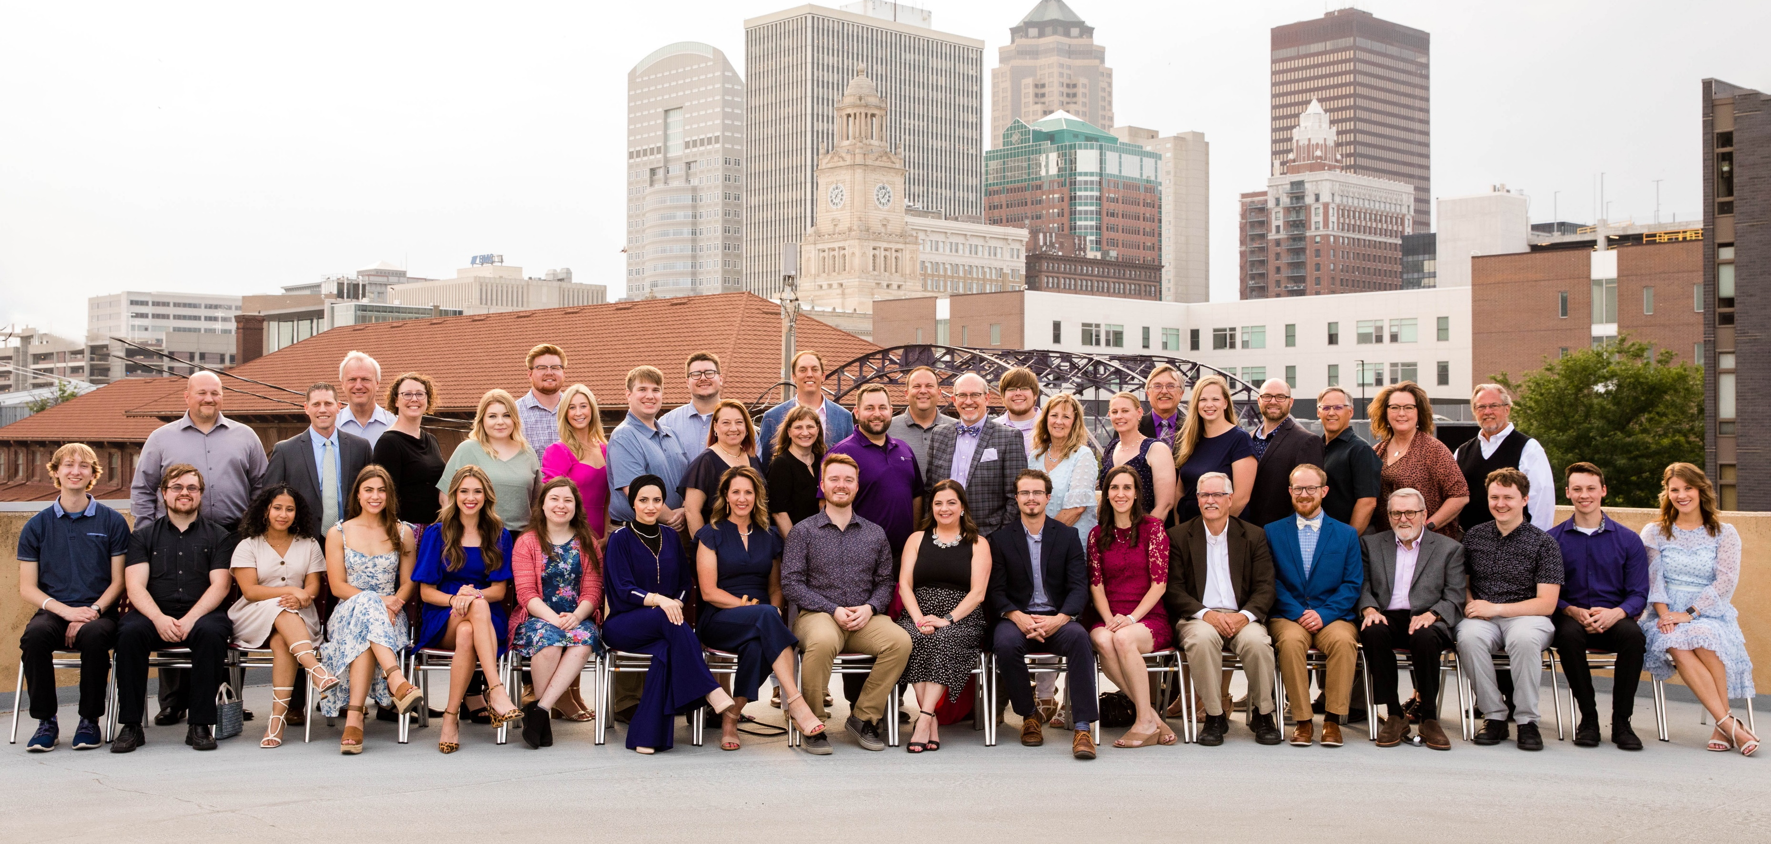
INTRODUCTION
Continuous operation since 1898
Offices in Sioux City, Des Moines, Dubuque (Iowa) and Milwaukee (Wisconsin)
Extensive experience throughout the Midwest Region, over 150 library projects
Outstanding record for cost and schedule control
Design approach that focuses on the owner, staff and community involvement
FEH Design offers experience provided by our four offices including architecture, structural engineering, interior design, WELL and LEED accredited professionals.

Slide 3
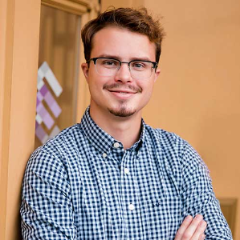
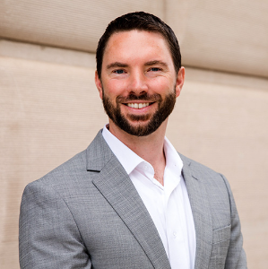
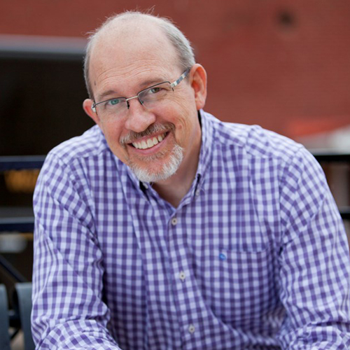
THE FEH TEAM
Mark Taylor, AICP, AIA, ASSOC
Project Manager
Brady Ludvik
Architectural Designer
Cole Henson, AIA, LEED AP
Principal in Charge
Kevin Eipperle, AIA, LEED AP
Principal in Charge

Slide 4
03 / ADVISORY
TASK FORCE
ROLE
The Advisory Task Force serves as a sounding board, providing guidance, advice, and feedback to the Board.
Task Force members will gain knowledge of , or experience with, the facilities, and are capable of articulating the views of the community.
They understand the Goals for Success for the Library, can evaluate possible implementation options, will consider the potential cost of proposed options, make advisory recommendations to the Board.

Slide 5
04
/
GOALS FOR SUCCESS - DRAFT
A Library that…
Meets current and future needs of the community.
Provides the most efficient use of space.
Be a community hub.
Provides free private meeting spaces.
The entrance should be welcoming and visible to staff and other patrons.
Provides clear wayfinding and directional strategy.
Maintains beauty of the building
Safe place for teens, children, everyone!
Space to support outdoor programs.
Supports small business entrepreneurship.
Update and provide an efficient building infrastructure.
Culturally, financially, environmentally sustainable.

Slide 6
04
/
REVIEW AGENDA
Introductions
Review agenda and today’s goals
Advisory Task Force Role
Review Draft Goals for Success
Relevance of a 21st Century Public Library
Current Library Stats
Review process
Space Needs Evaluation & Program of Spaces
Condition Assessment
Advisory Task Force input, what would you like us to study?
Design workshop – SPARK (May 22 and 23)
Site Options
Review Schedule
Dates & location for future meetings & workshops, virtual & hybrid
Next steps, assignments, and next meeting – April 17, 2024, ATF meeting at 6:30 PM
Think about needs and key participants who should be added

Slide 7
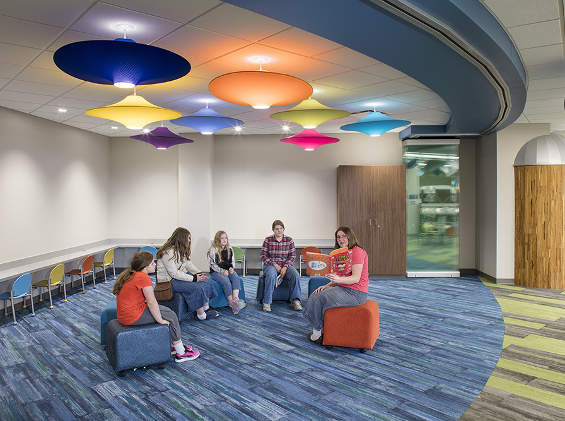
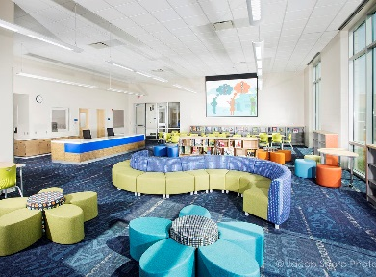
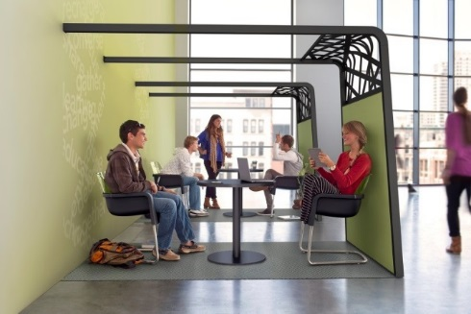
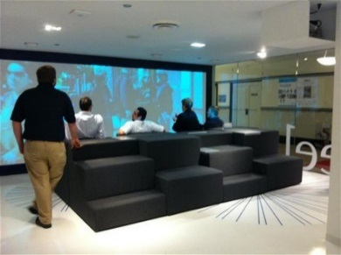
05
/
21ST CENTURY LIBRARIES
Young adult, youth spaces
Flexible spaces & furnishings
Integrated technology
Marketplace/neighborhood
Makerspaces
Collaboration, gathering

Slide 8
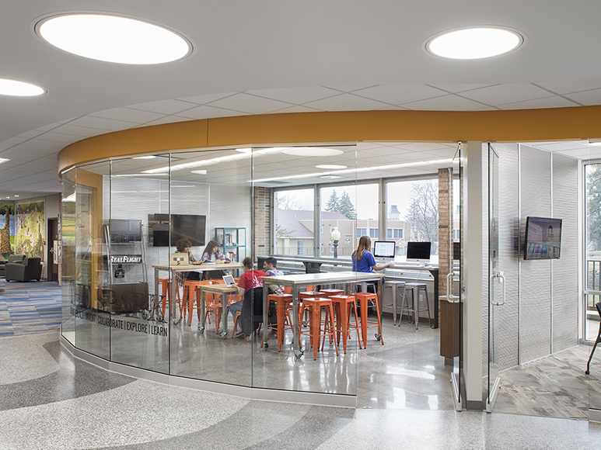
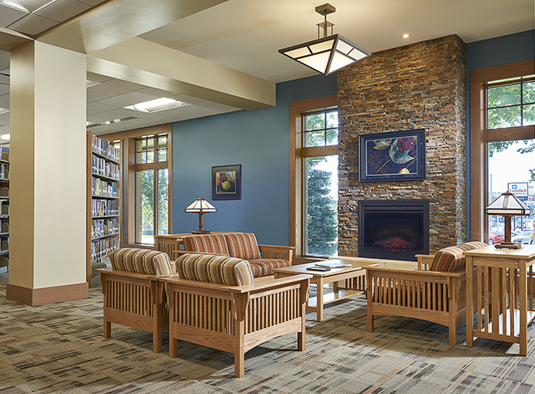
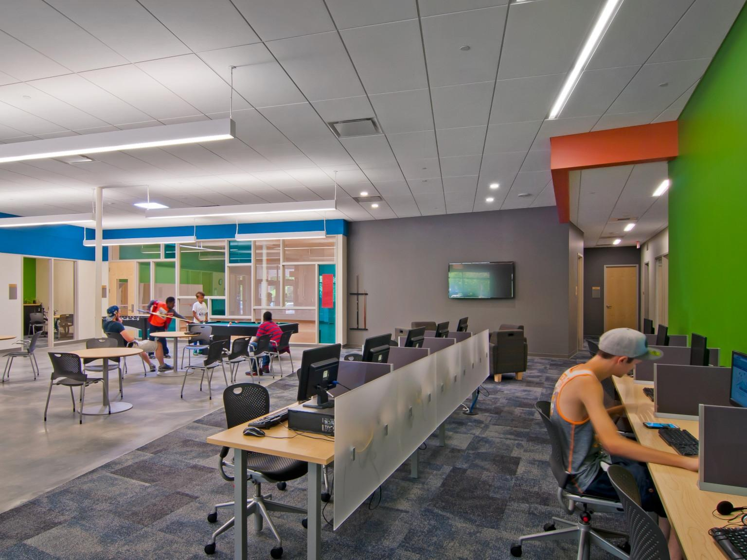
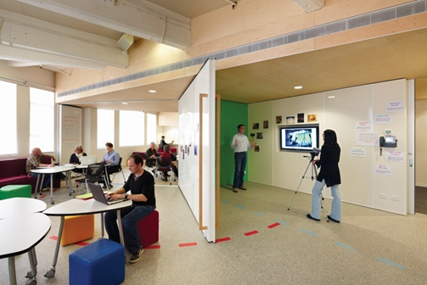
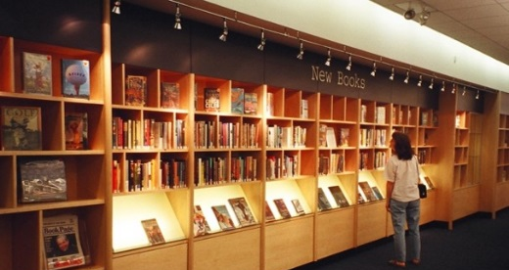
05
/
21ST CENTURY LIBRARIES
Young adult, youth spaces
Flexible spaces & furnishings
Integrated technology
Marketplace/neighborhood
Makerspaces
Collaboration, gathering

Slide 9
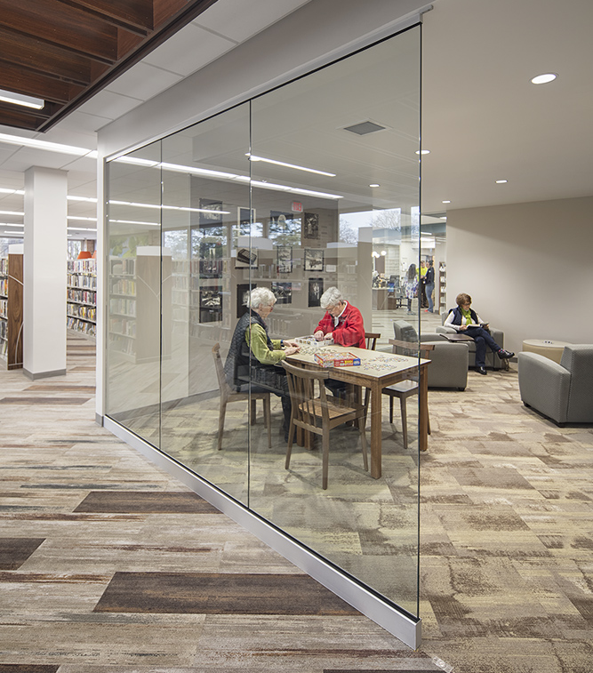
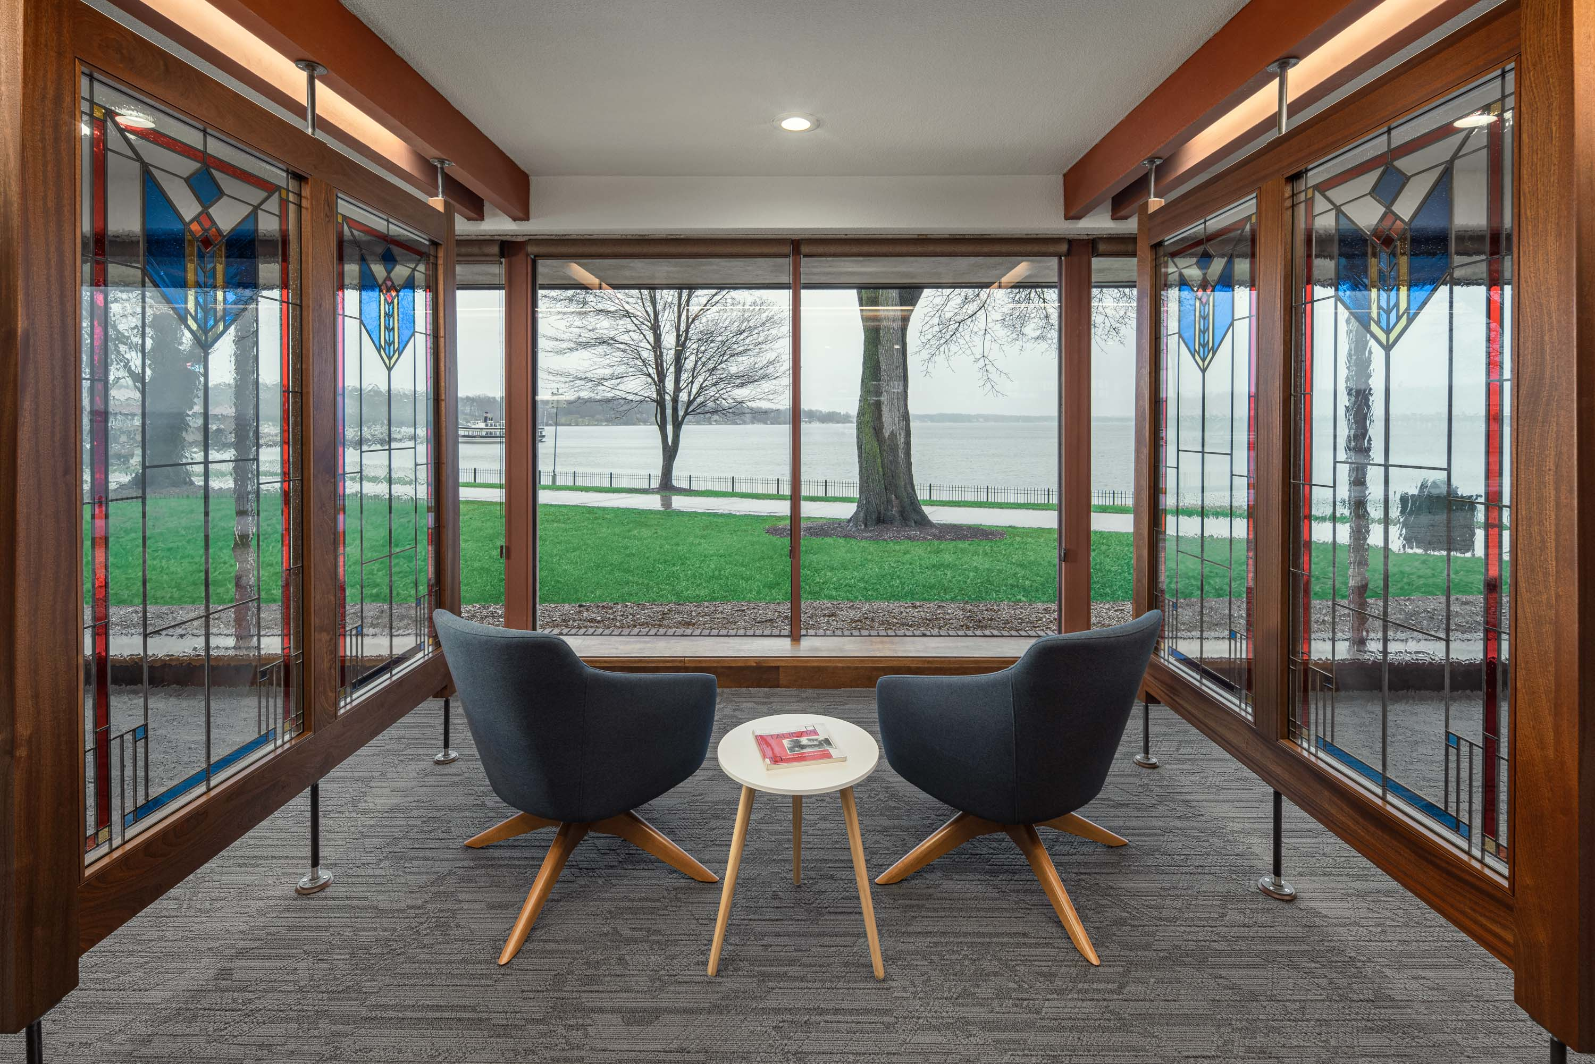
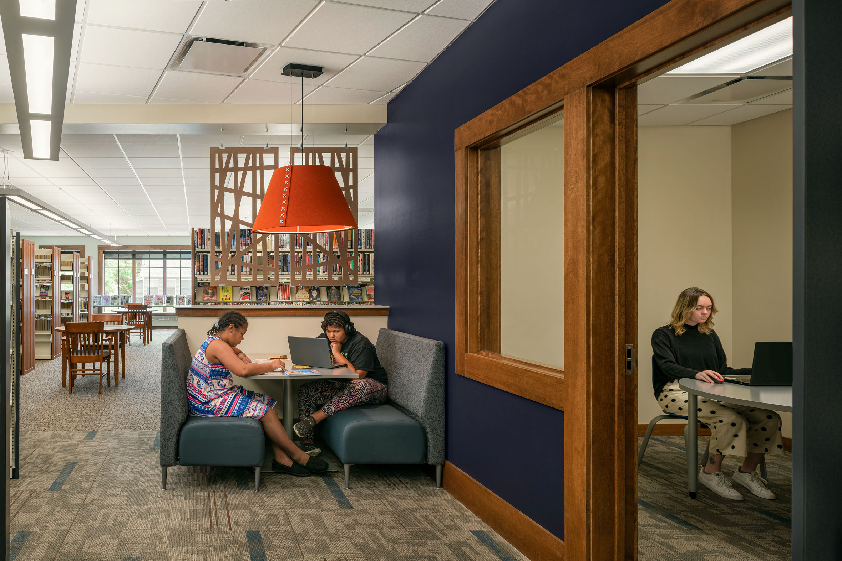
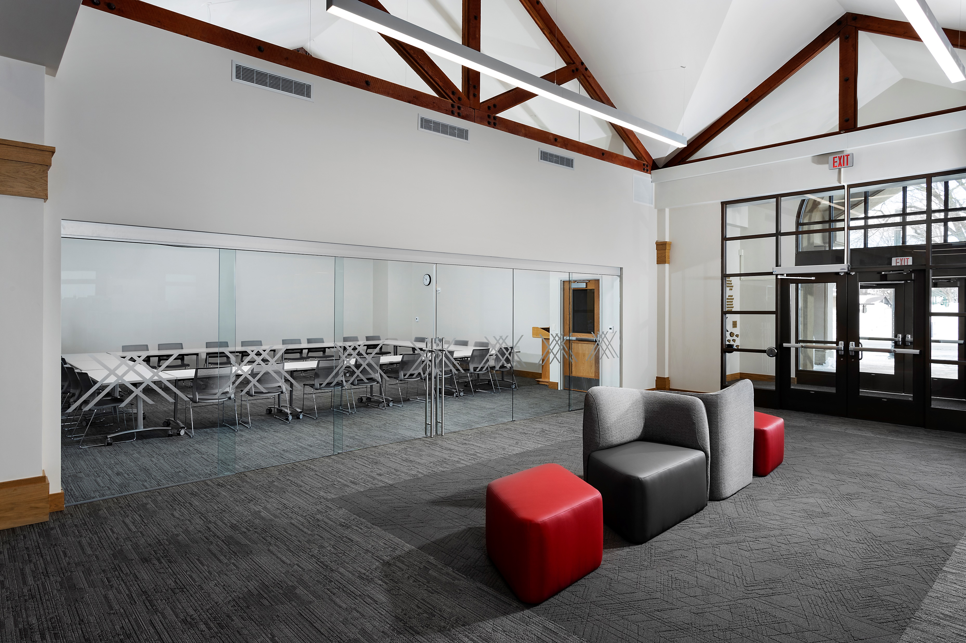
05
/
COMMUNITY MEETING SPACES
Meeting rooms
Gathering spaces
Event spaces
Celebration venues
Quiet places
Classroom and training spaces

Slide 10
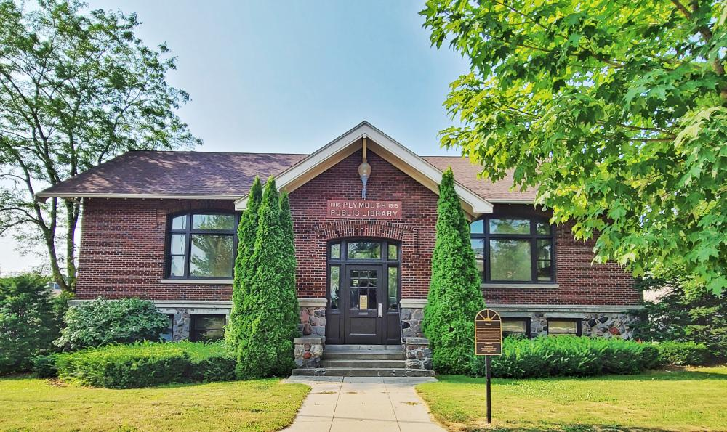
06
/
CURRENT LIBRARY STATS
Registered Users: 3,600 (City Residents) and 2,510 (Non-Resident)
Circulation: 98,787
Library Visits: 54,980
Programming: 252 programs
Programming attendance: 4,285
# Public Computers: 13
Computer Uses: 3,202
Website Visits: 13,070
Wireless Visits: 15,052
Materials Owned: 229,392 (books, audio, DVD, magazines/newspaper, kits, etc.)
Plymouth Library Room Uses: 345 (approx.)
Public Seating Space: 58

Slide 11
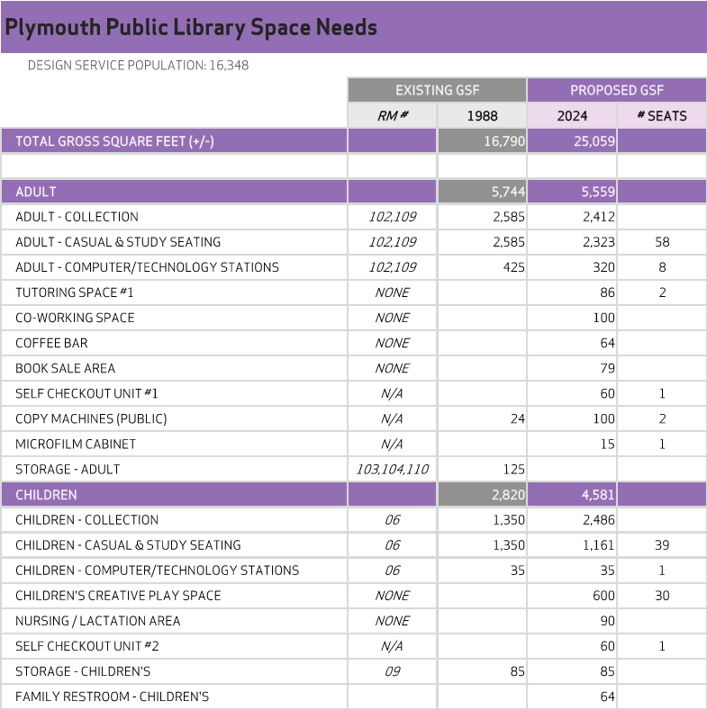
07
/
SPACE NEEDS PROGRAM - DRAFT

Slide 12
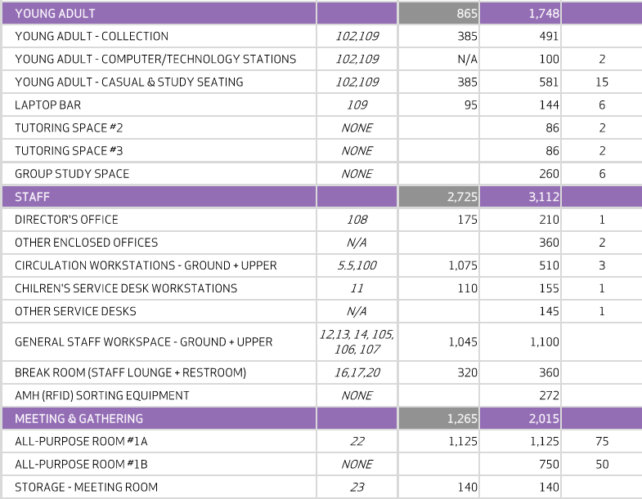
07
/
SPACE NEEDS PROGRAM - DRAFT

Slide 13
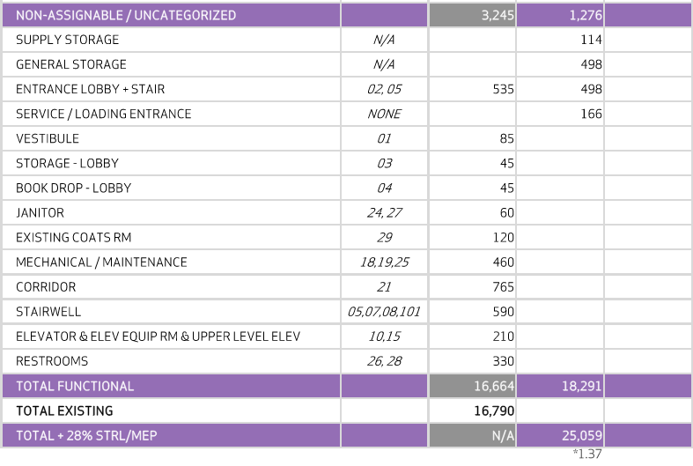
07
/
SPACE NEEDS PROGRAM - DRAFT

Slide 14
07
/
SPACE NEEDS PROGRAM - DRAFT

Slide 15
?
?
?
?
Questions?

Slide 16
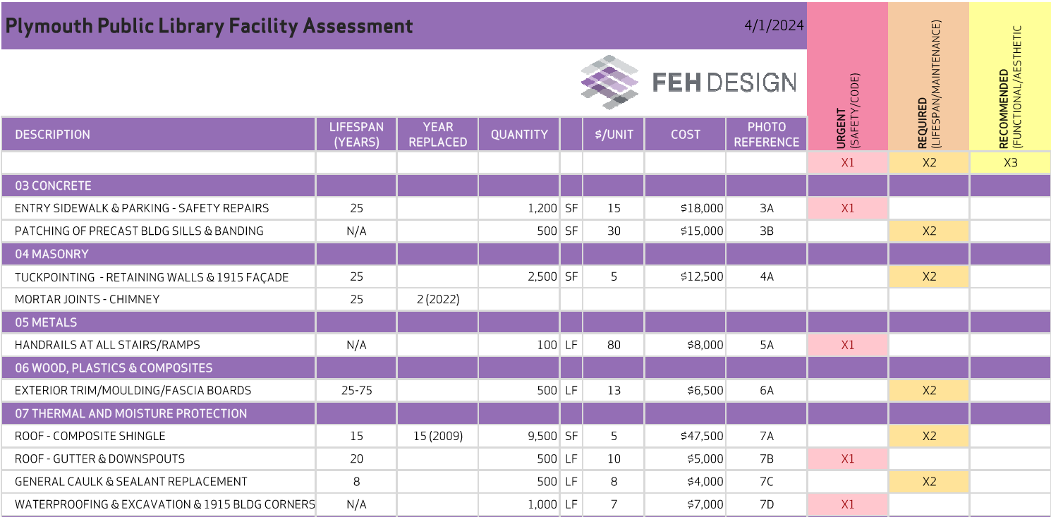
08
/
CONDITION ASSESSMENT - DRAFT

Slide 17
08
/
CONDITION ASSESSMENT - DRAFT

Slide 18
08
/
CONDITION ASSESSMENT - DRAFT

Slide 19
08
/
CONDITION ASSESSMENT - DRAFT

Slide 20
08
/
CONDITION ASSESSMENT - DRAFT

Slide 21
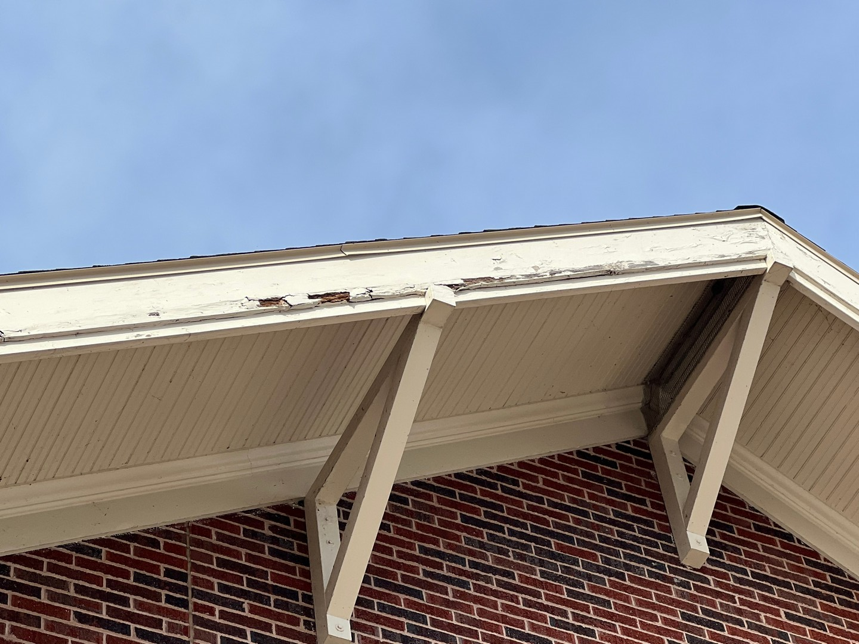
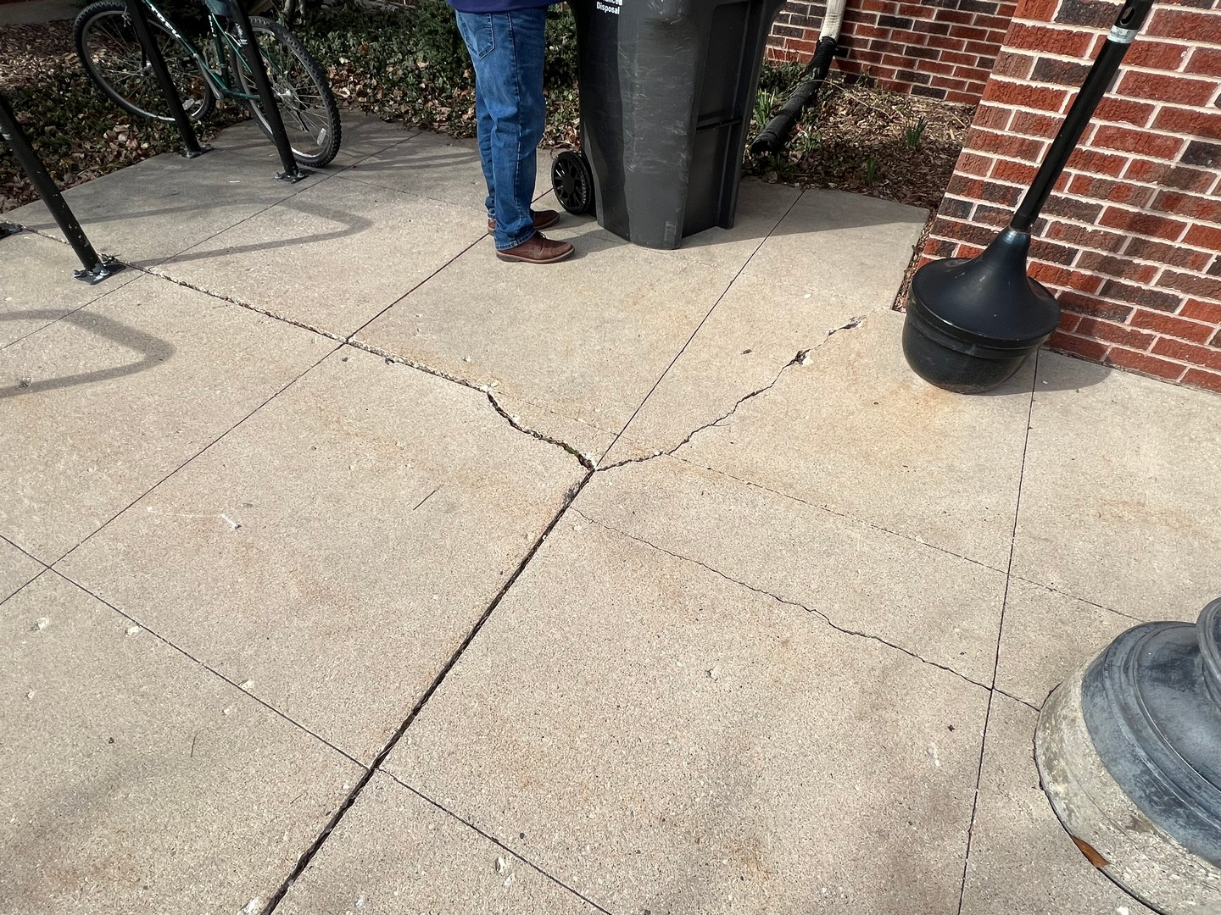
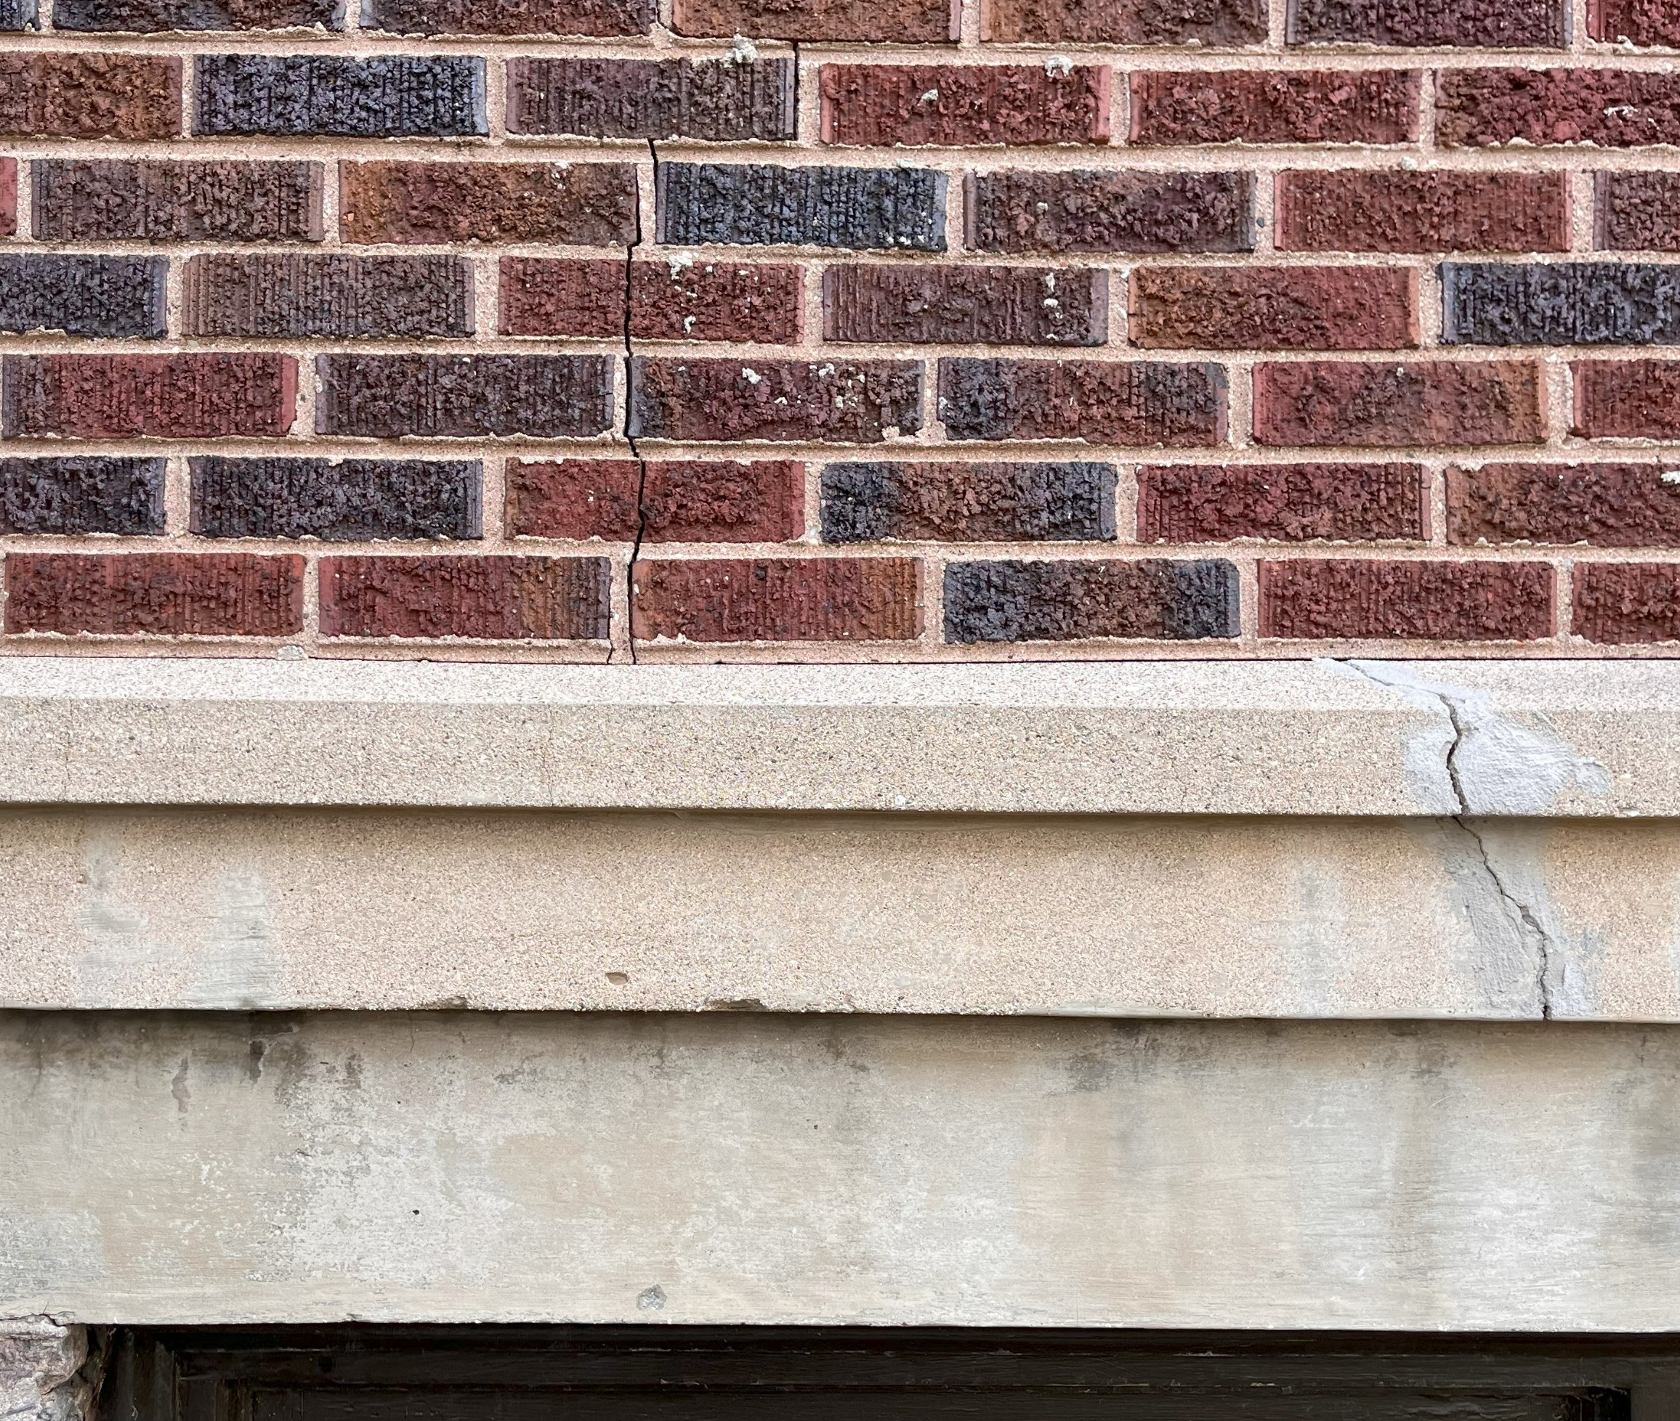
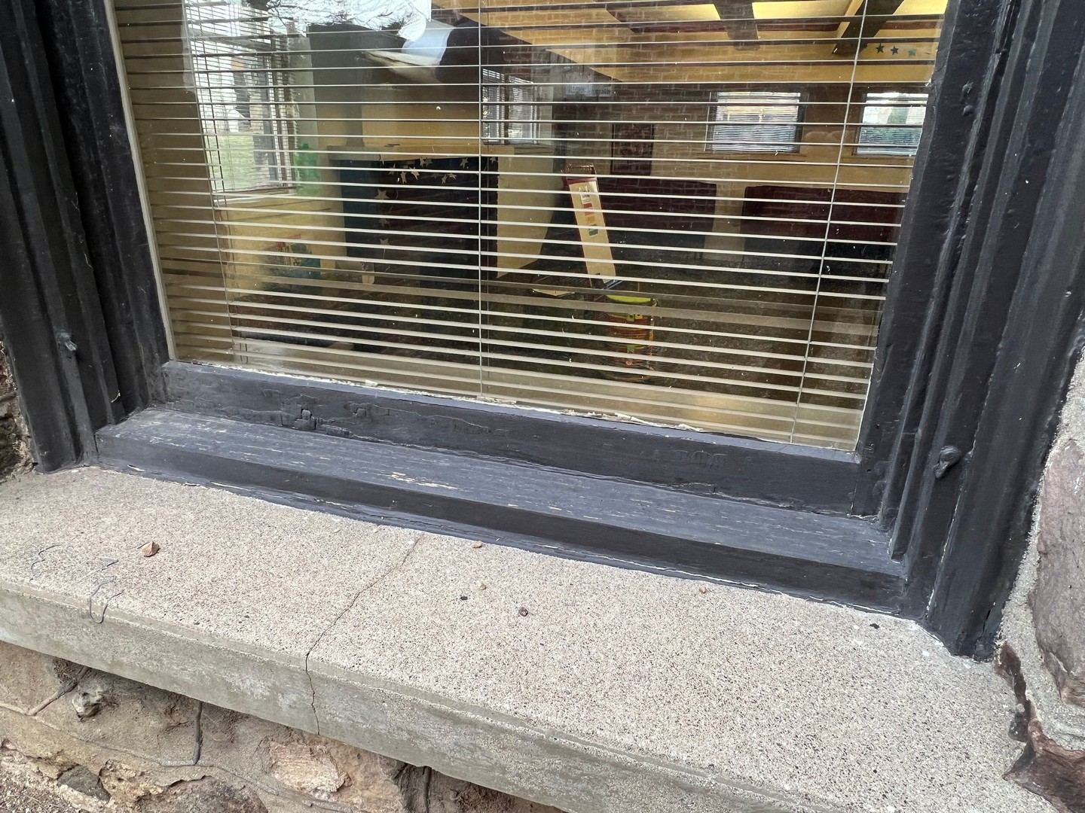
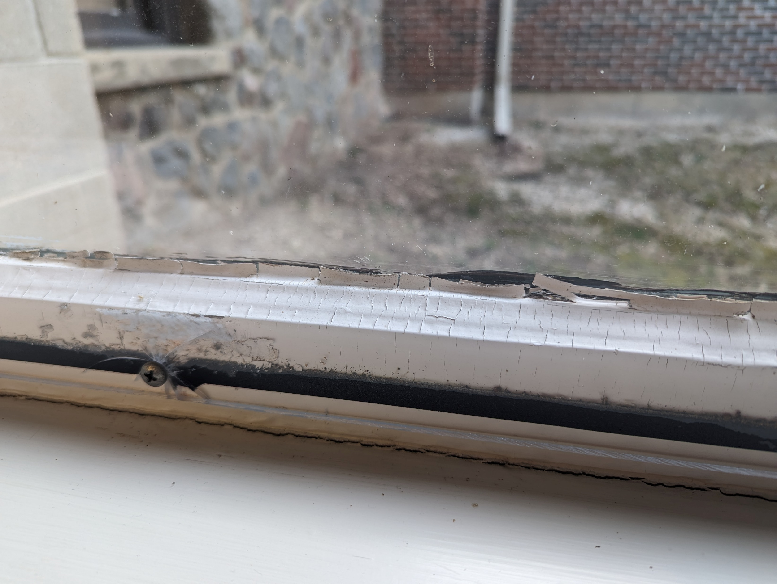
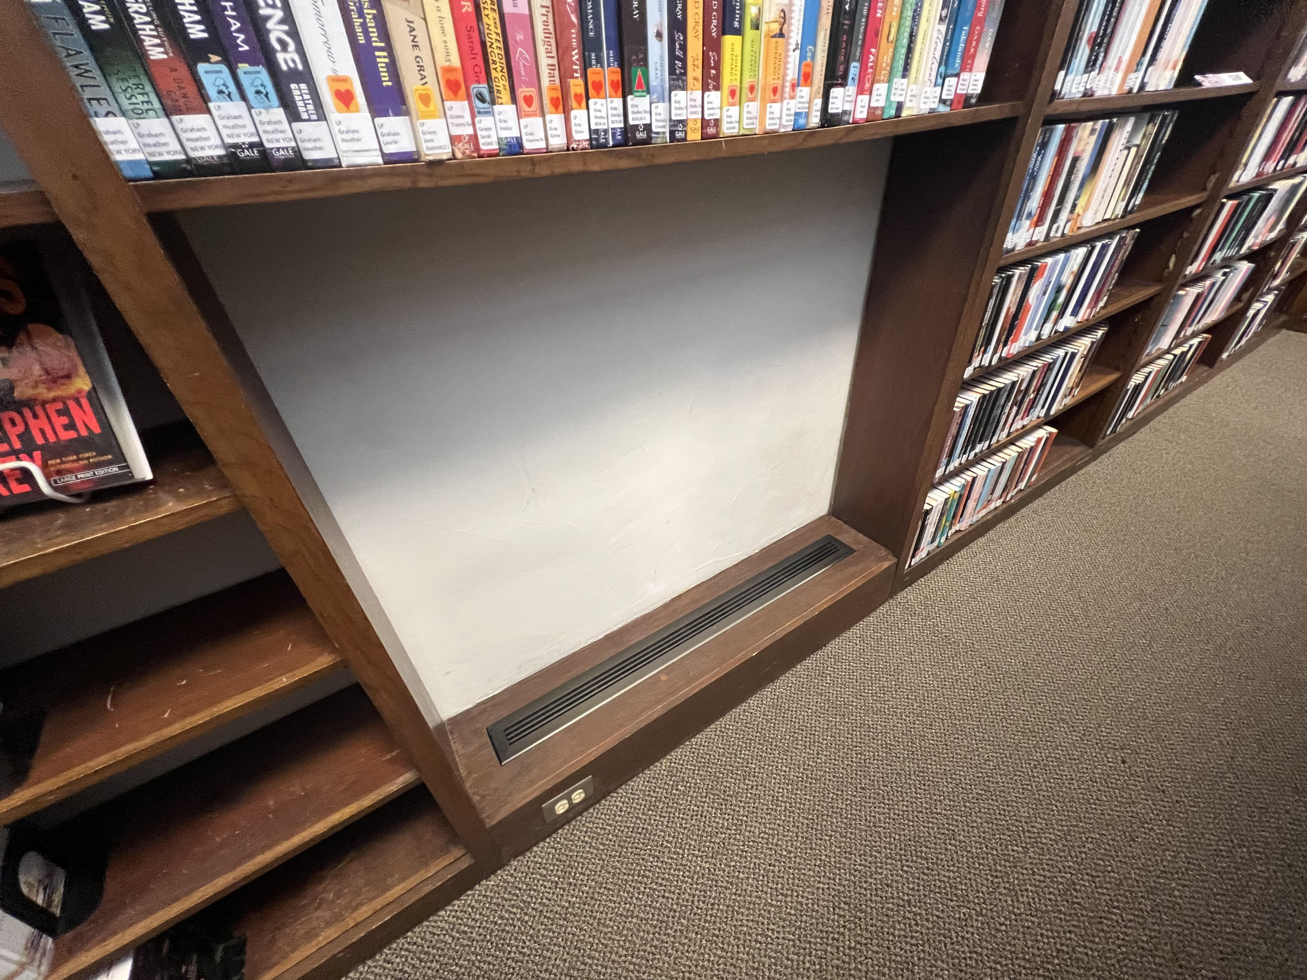
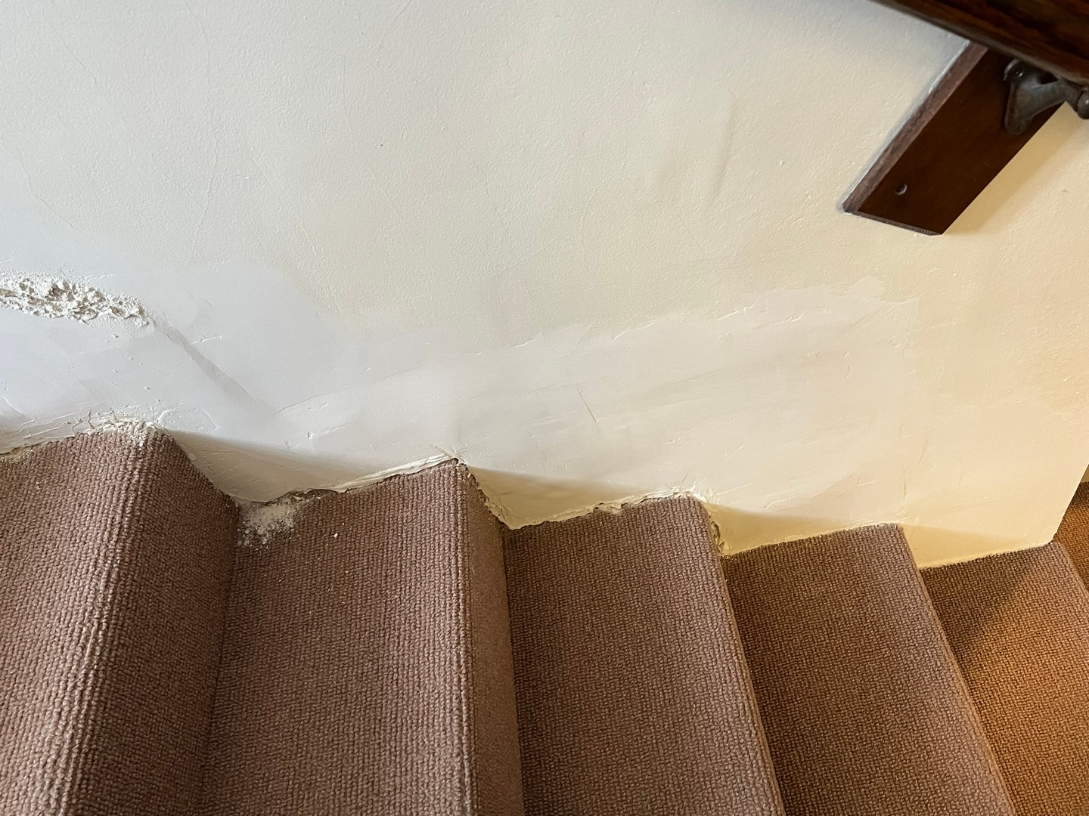
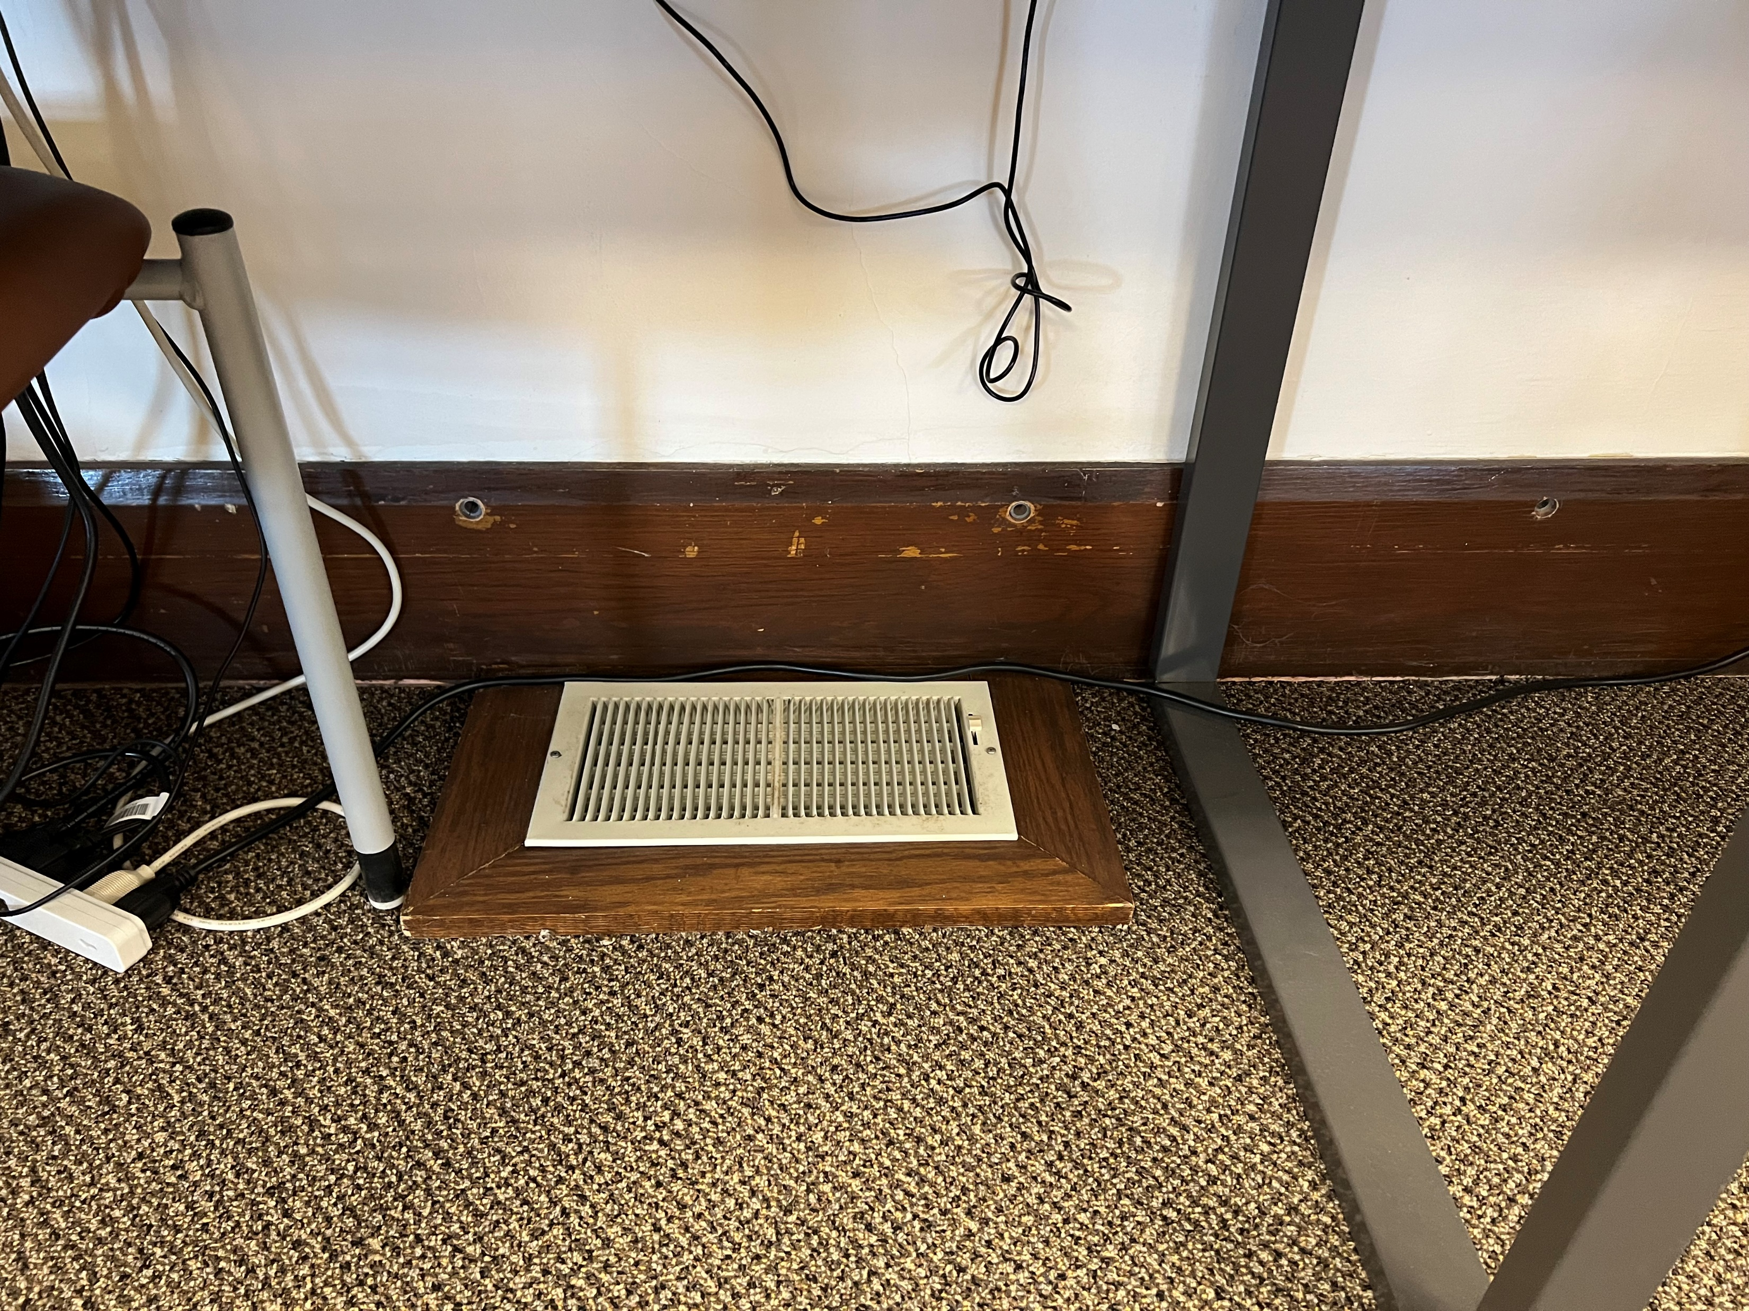
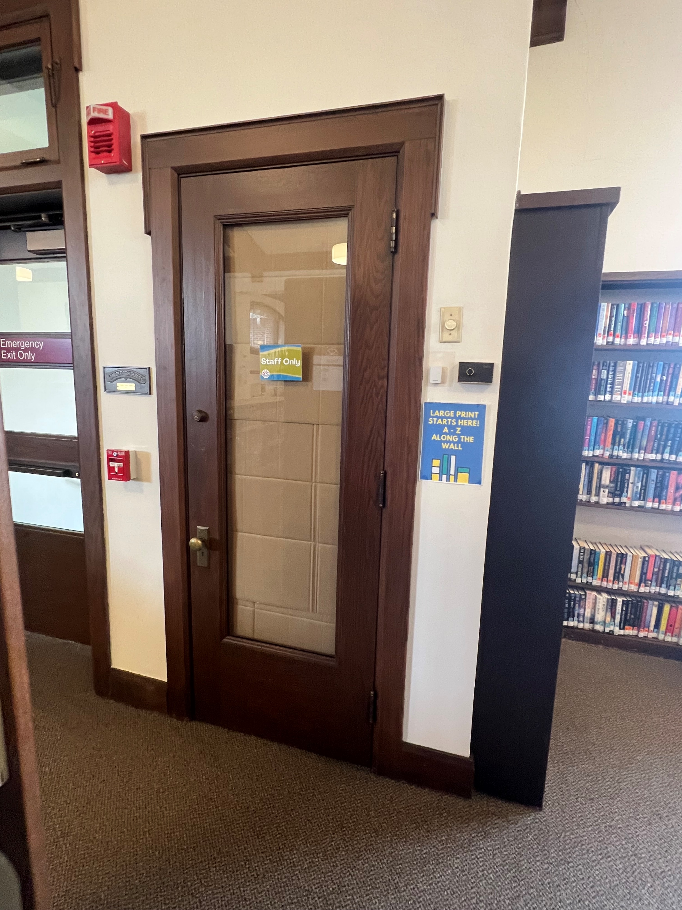
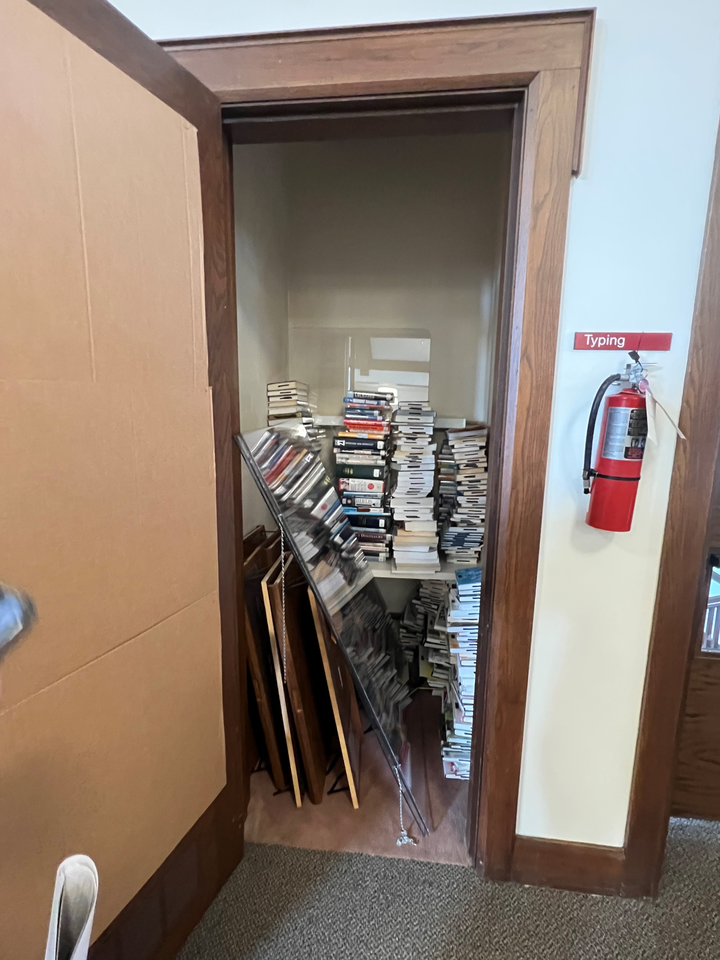
08
/
CONDITION ASSESSMENT - DRAFT
3A
3B
6A
8A
8A
9A
9C
9D
8B
8B

Slide 22
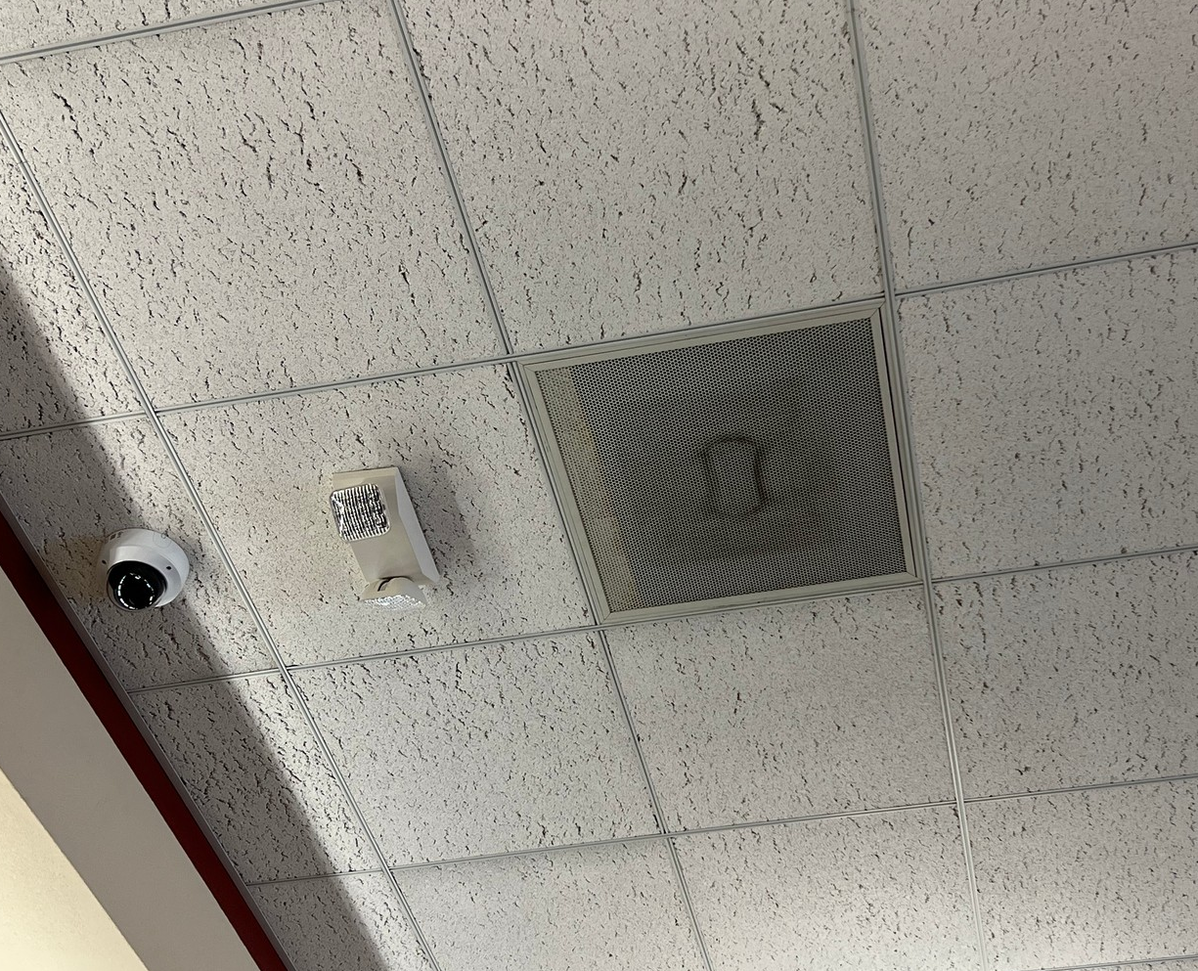
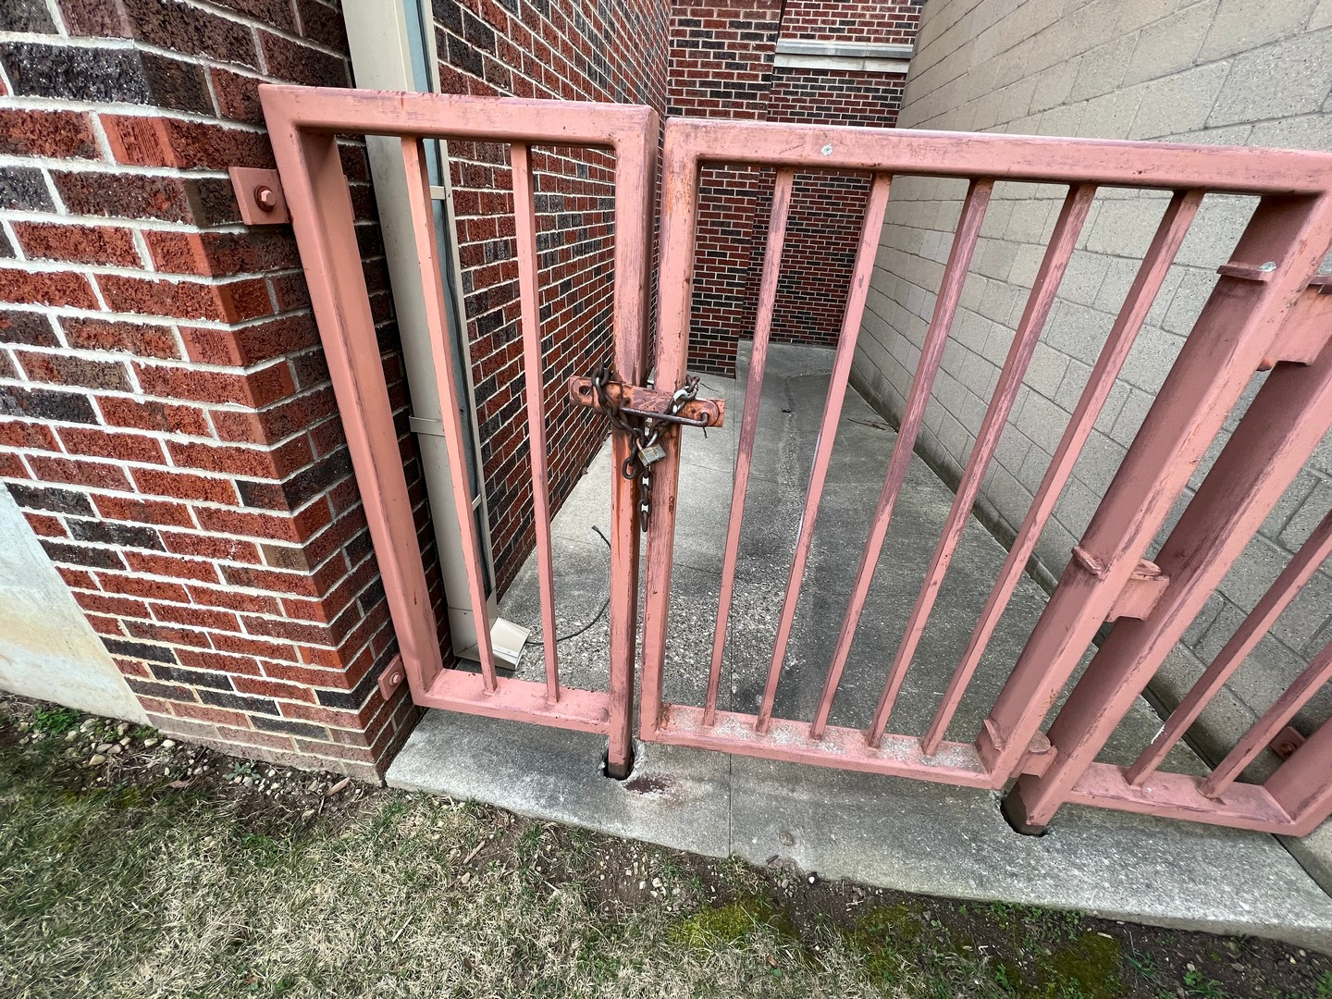
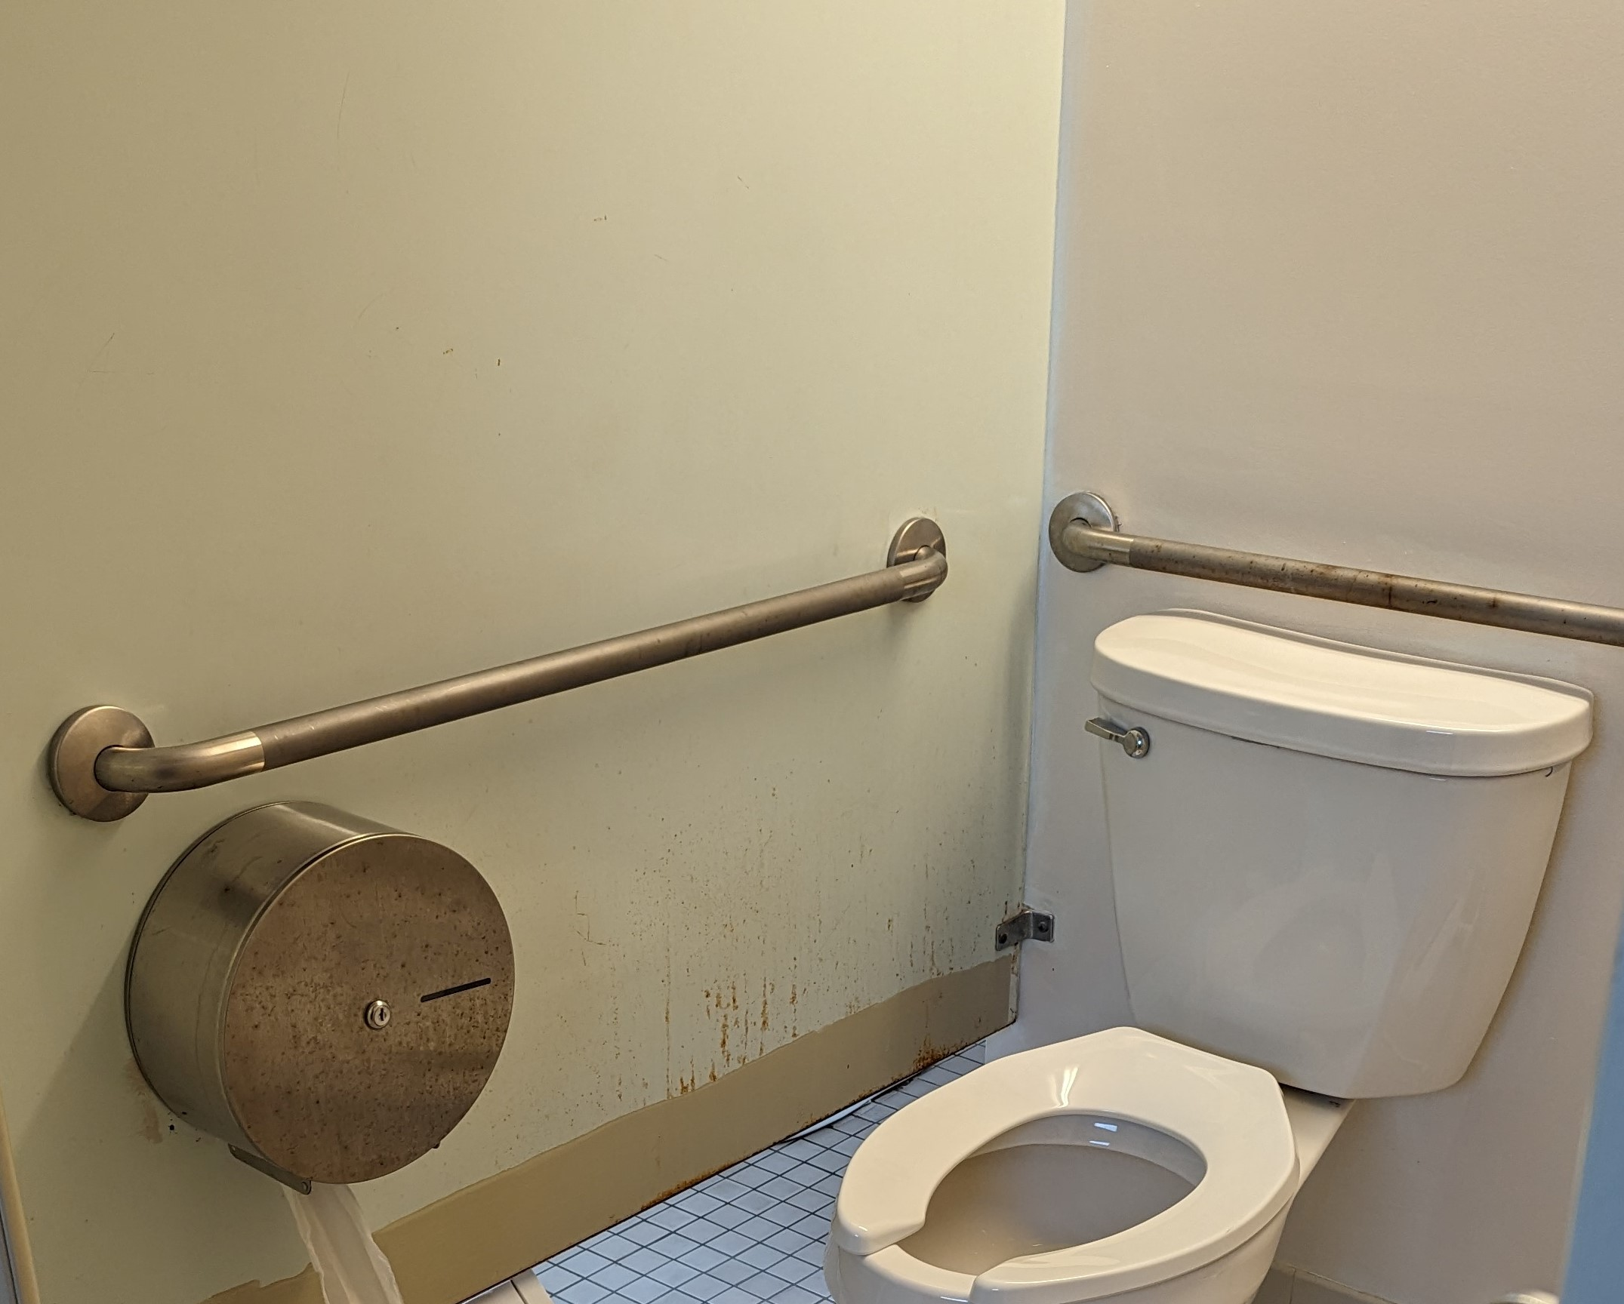
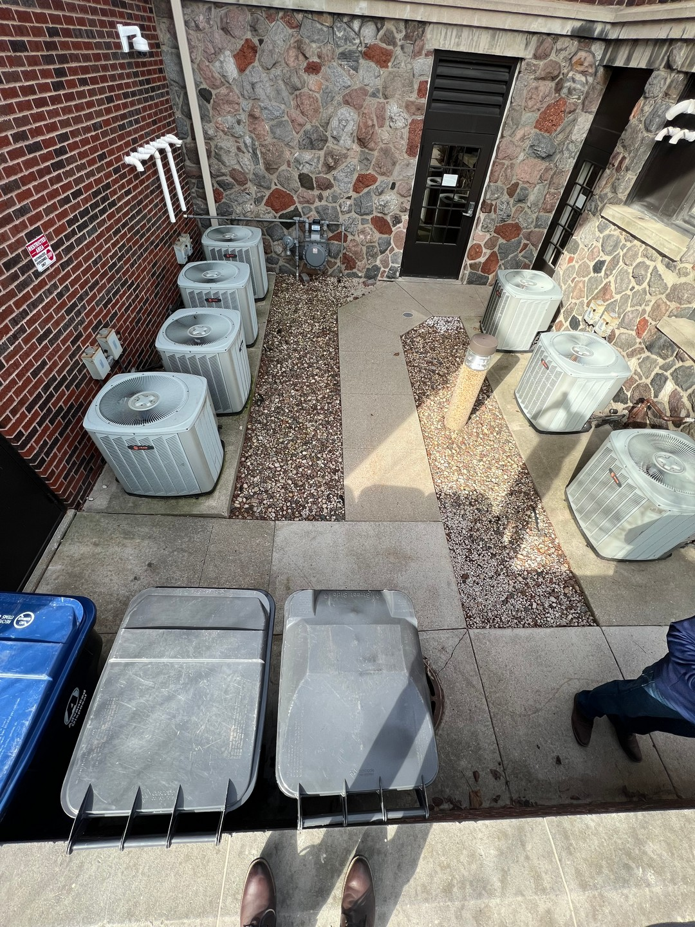
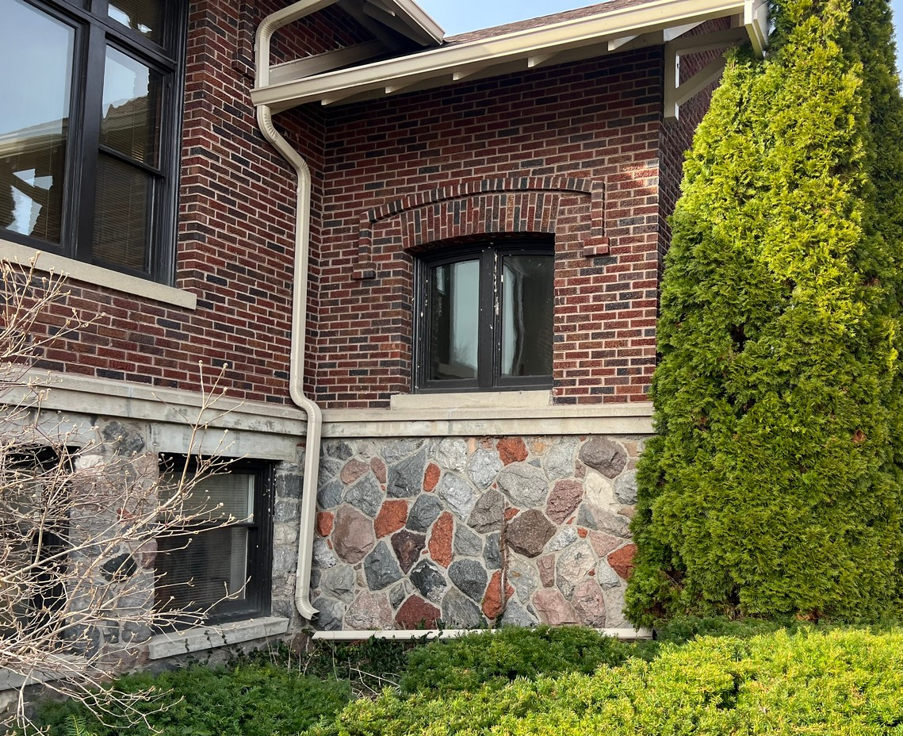
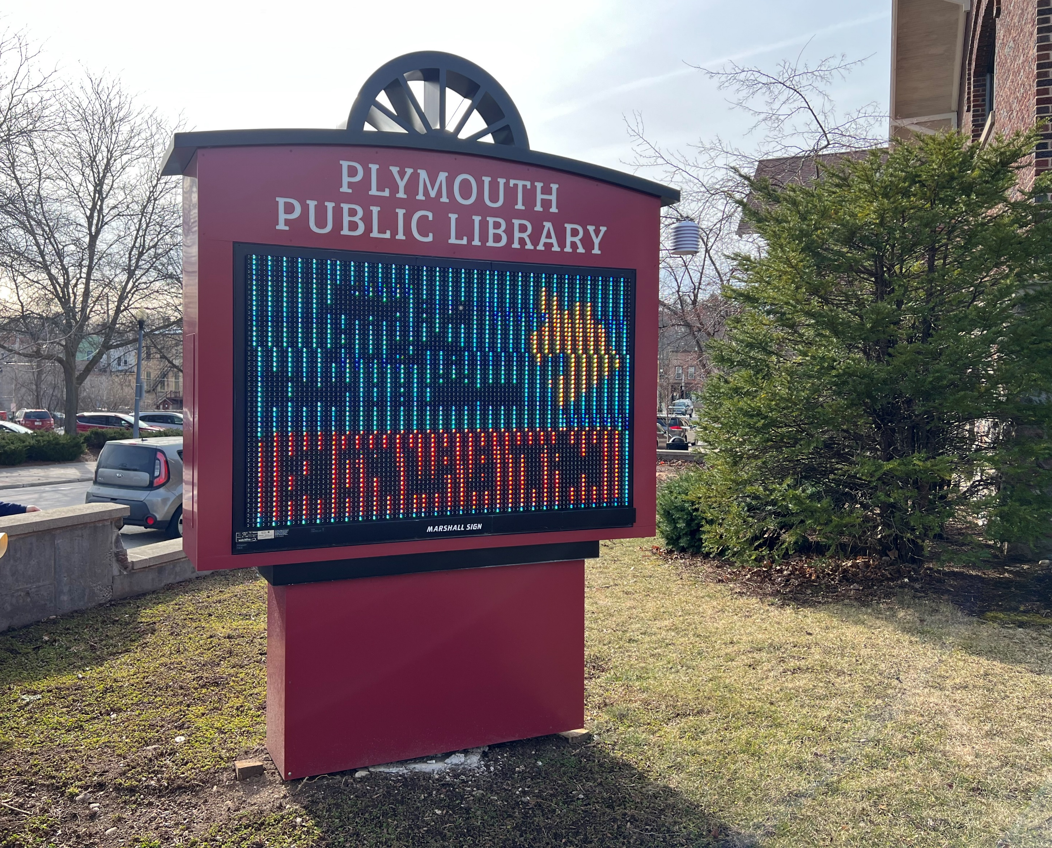
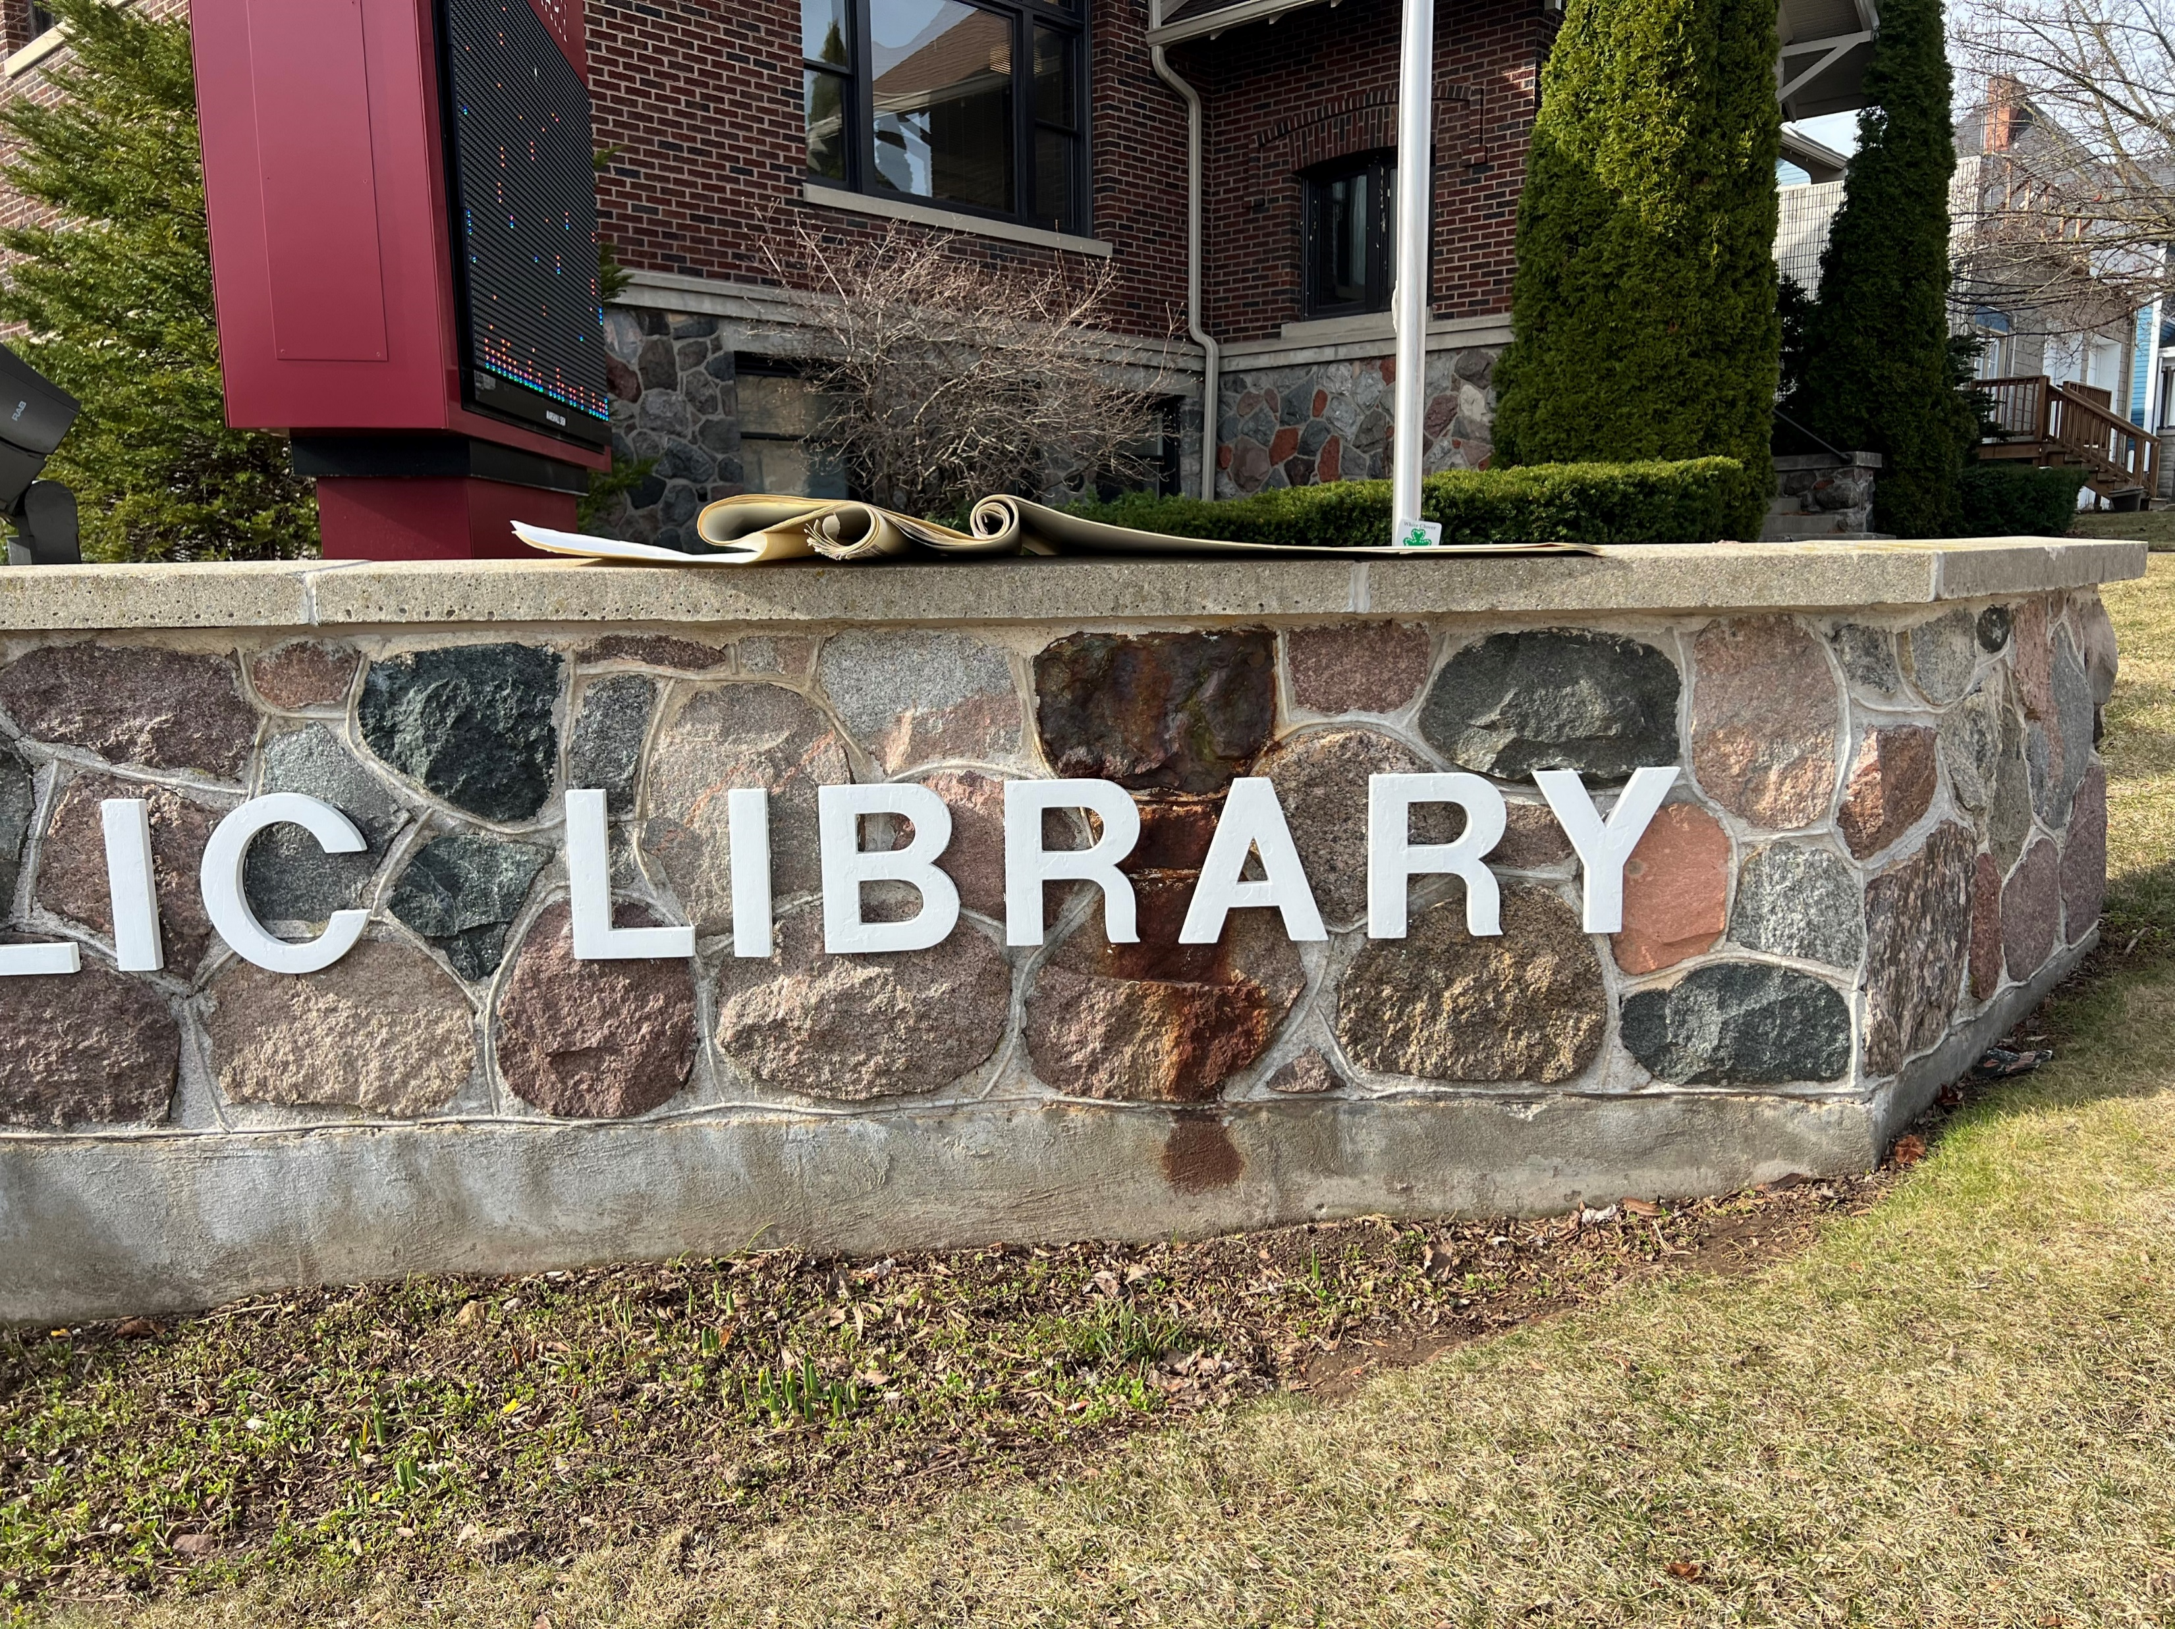
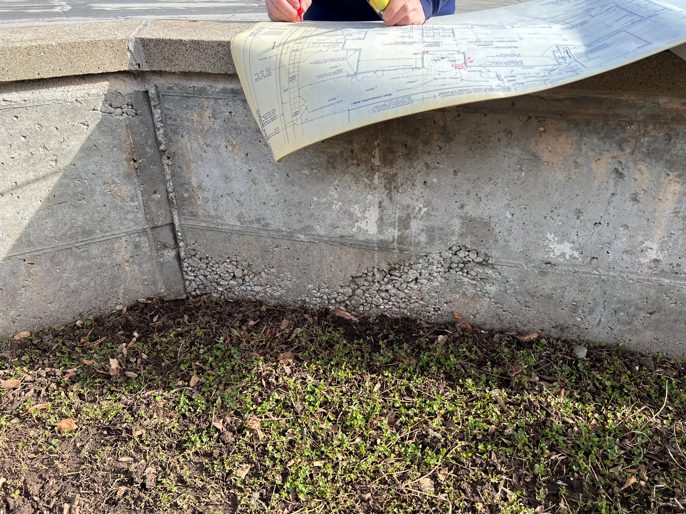
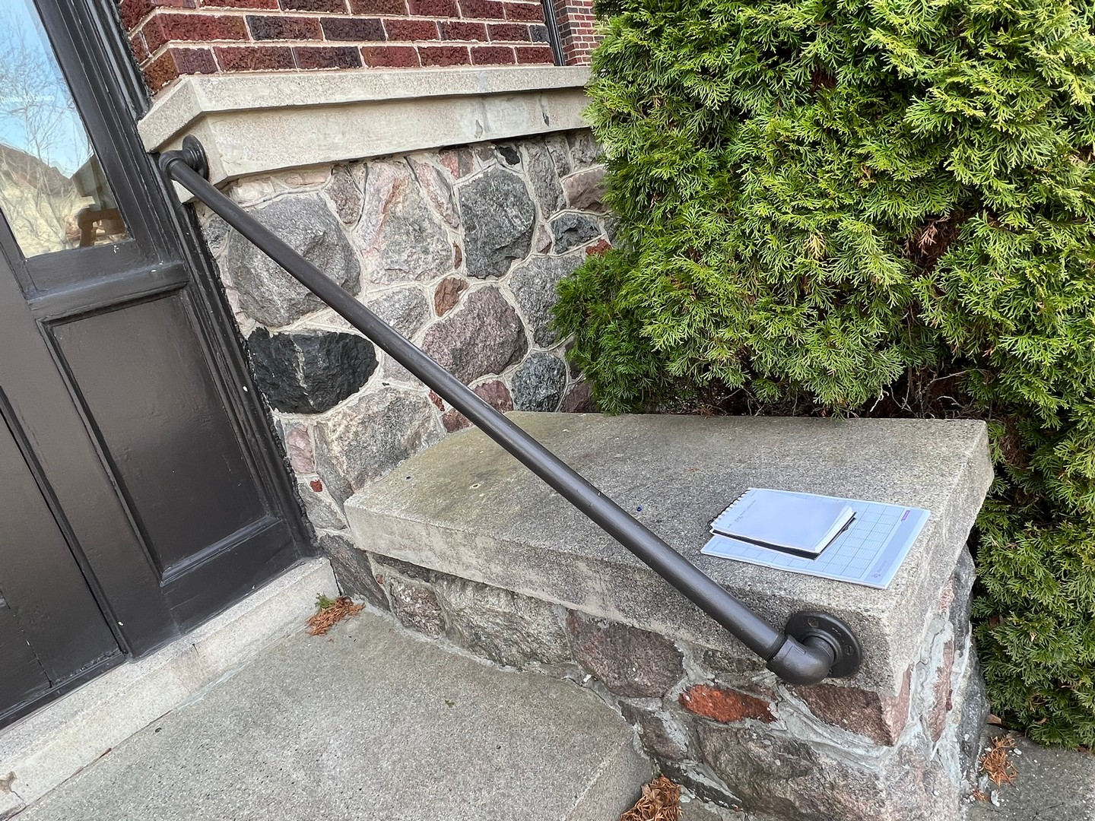
08
/
CONDITION ASSESSMENT - DRAFT
9E
9H
10A
32B
23A
32D
32G
32G
32H

Slide 23
08
/
CONDITION ASSESSMENT - DRAFT
LIBRARY NEEDS:
= $823,350
= $825,575
= $337,900
= $1,986,825
= 5.5M - 6M
= 8,270 SF
URGENT
REQUIRED
RECOMMENDED
TOTAL INVESTMENT
FOR REFERENCE: COST OF 1988 ADDITION (11,390 SF) IN TODAY’S DOLLARS (2023)
ADDITIONAL SQUARE FOOTAGE REQUIRED TO MEET TODAY’S NEEDS

Slide 24
?
?
?
?
Questions?

Slide 26
WHAT IS A SPARK SESSION?
It is a Fast-paced, Engaging, Highly-focused Design Session.
^{FAST-PACED}
^{ENGAGING}
^{HIGHLY-FOCUSED}
^{DESIGN}
In a 1 or 2 day session we create concept drawings in a short span of time based on your ideas. These concepts are then presented creating awareness and enthusiasm.
Input comes from your selected committee or from the collective thoughts of your entire community or business. Having a broad base of support, reflects the needs and desires of the community, school or business, and develops built-in ownership.
Our team of designers set up shop in your space with their design toolkits. There, we focus all our attention on listening and responding to your suggestions. We bring our tools, our creativity but no preconceived notions as we work with you.
Through the Spark Session, multiple design concepts are created. During the day we step back, reflect and then refine the designs. The best move forward and a concept moves to a more refined design.

Slide 27
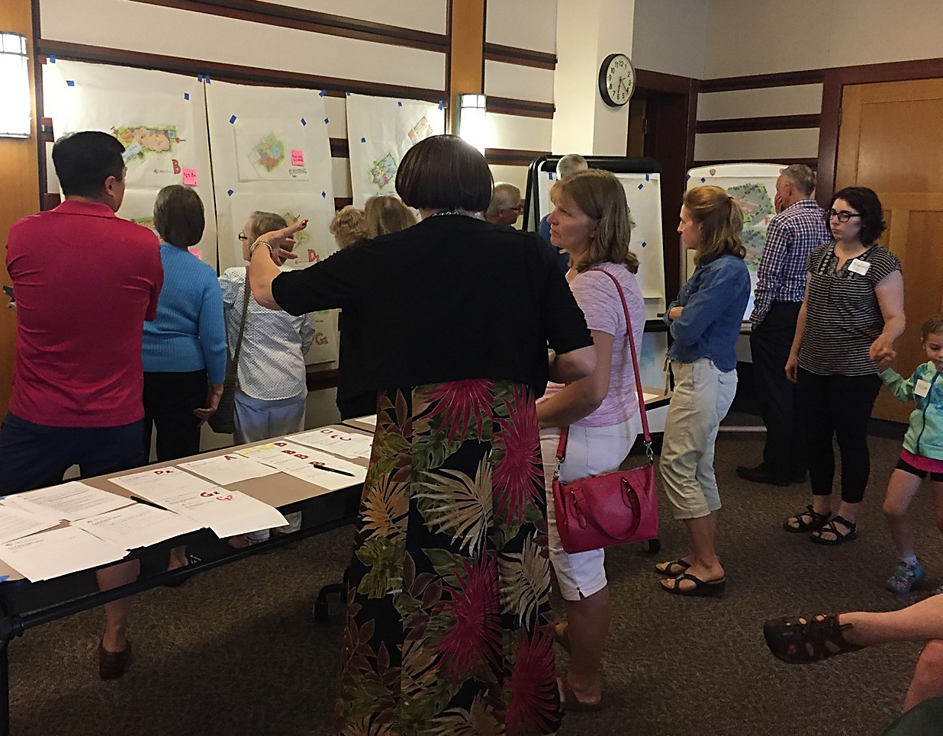
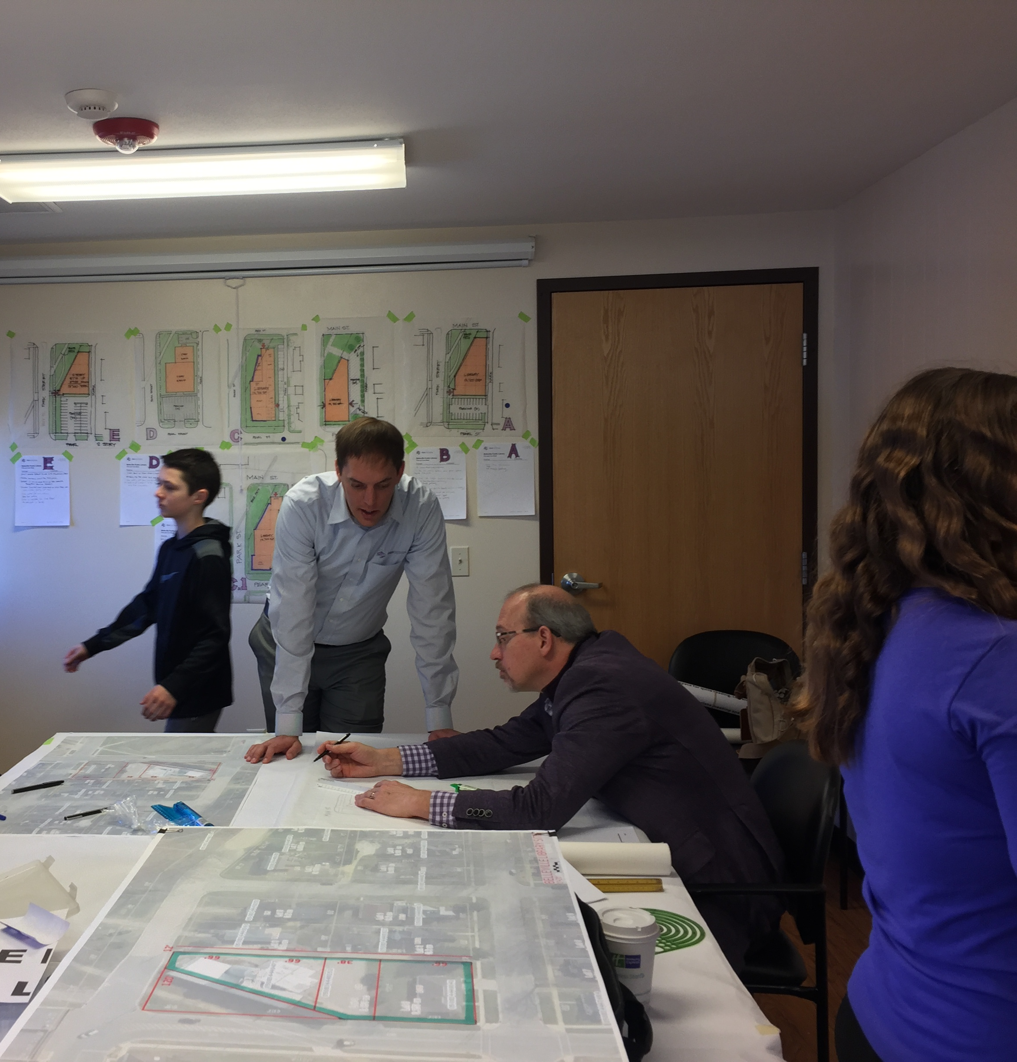
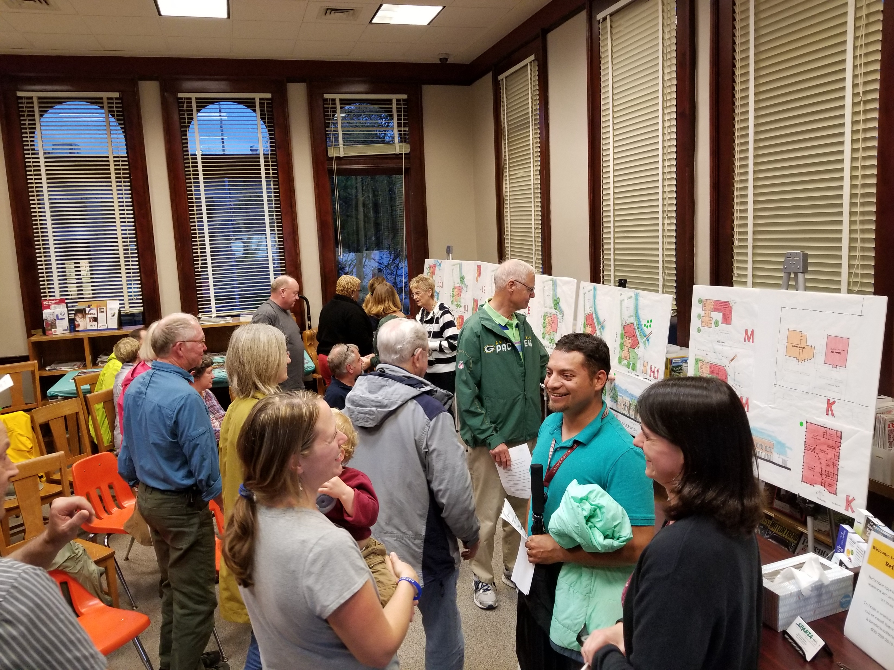
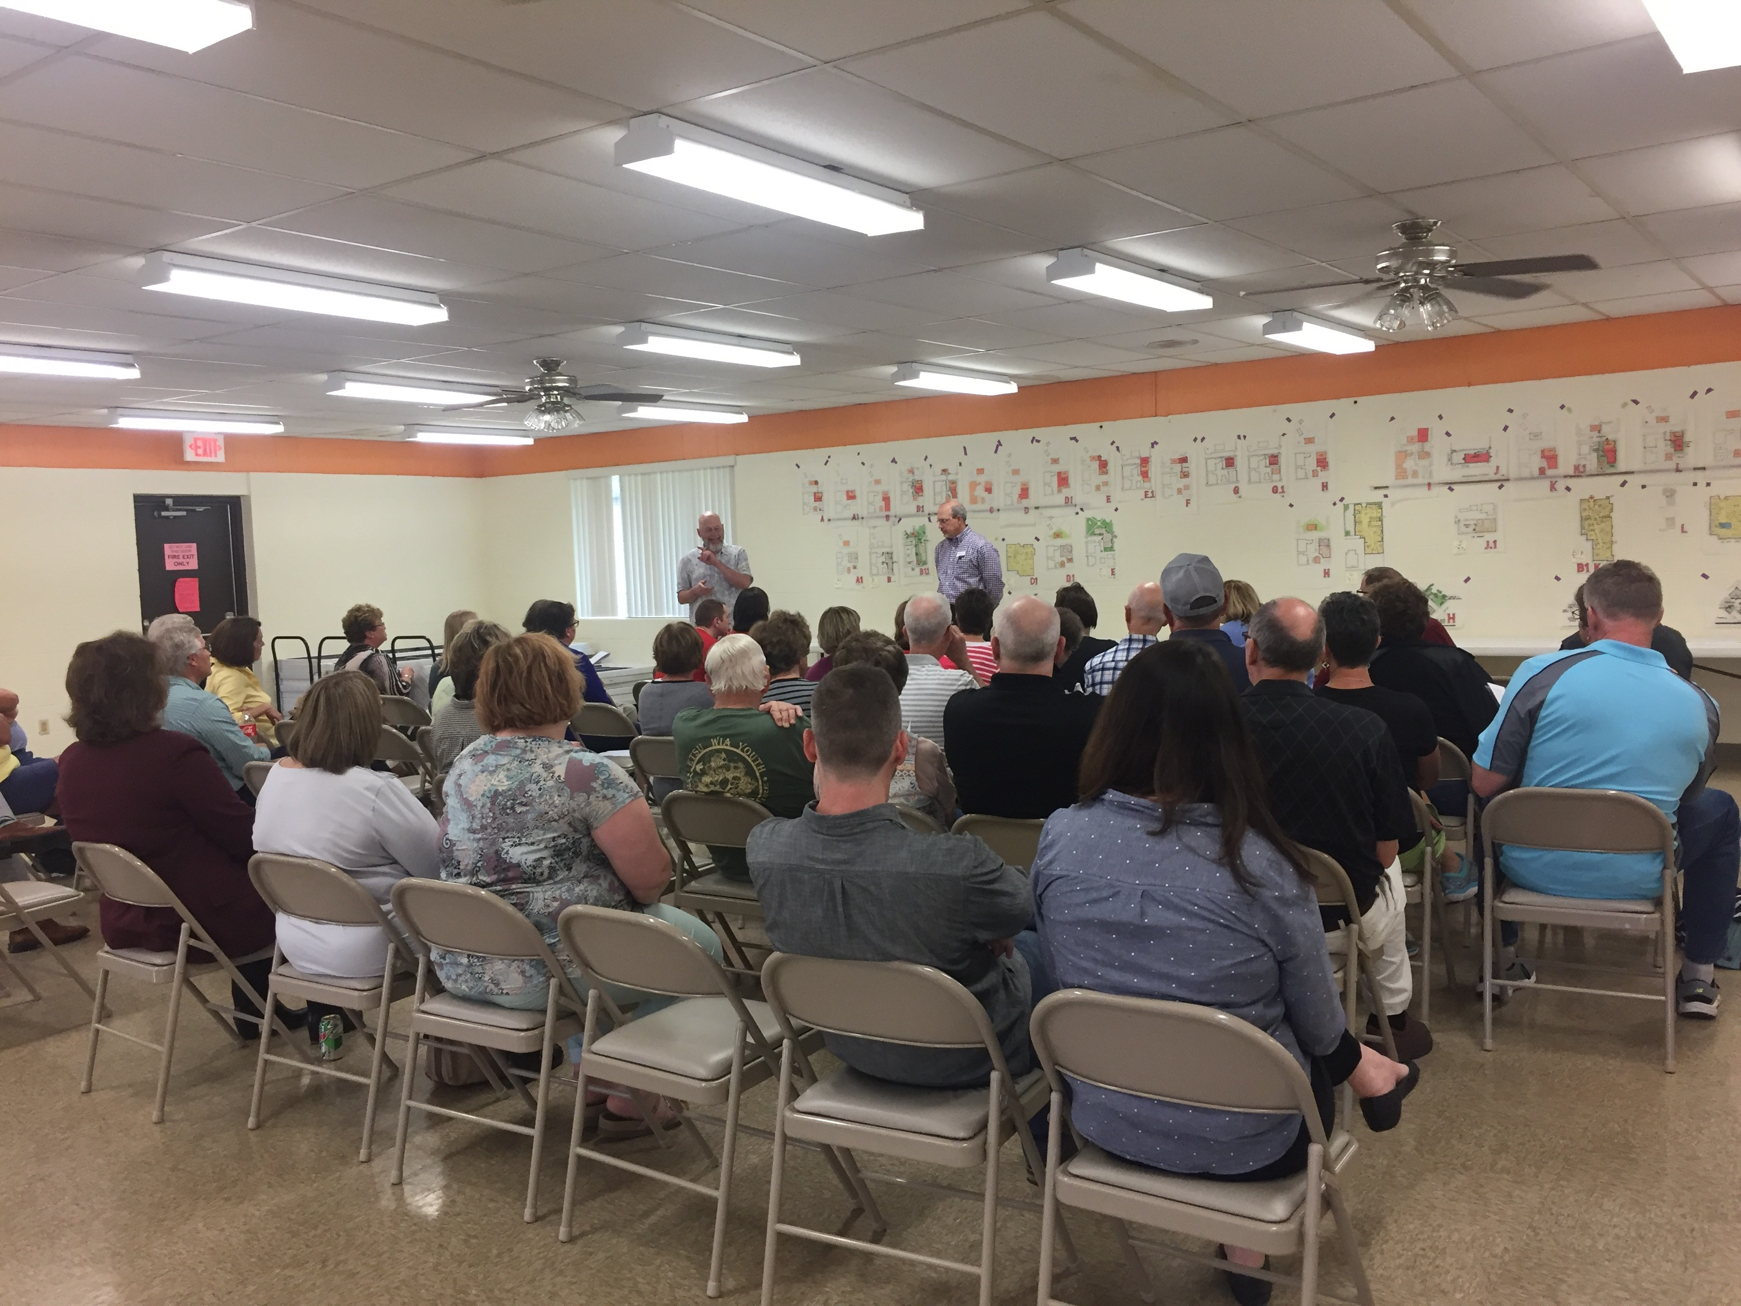
Notes:
library

Slide 28
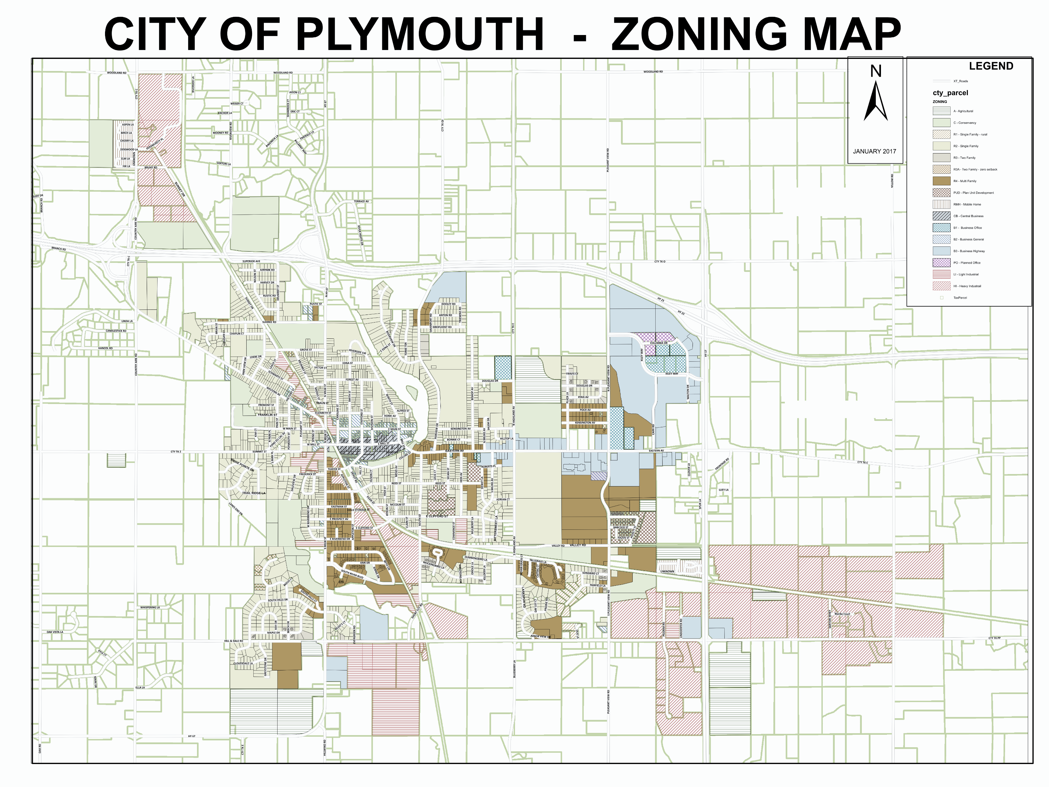
09
/
SITE – PLYMOUTH ZONING MAP
1

Slide 29
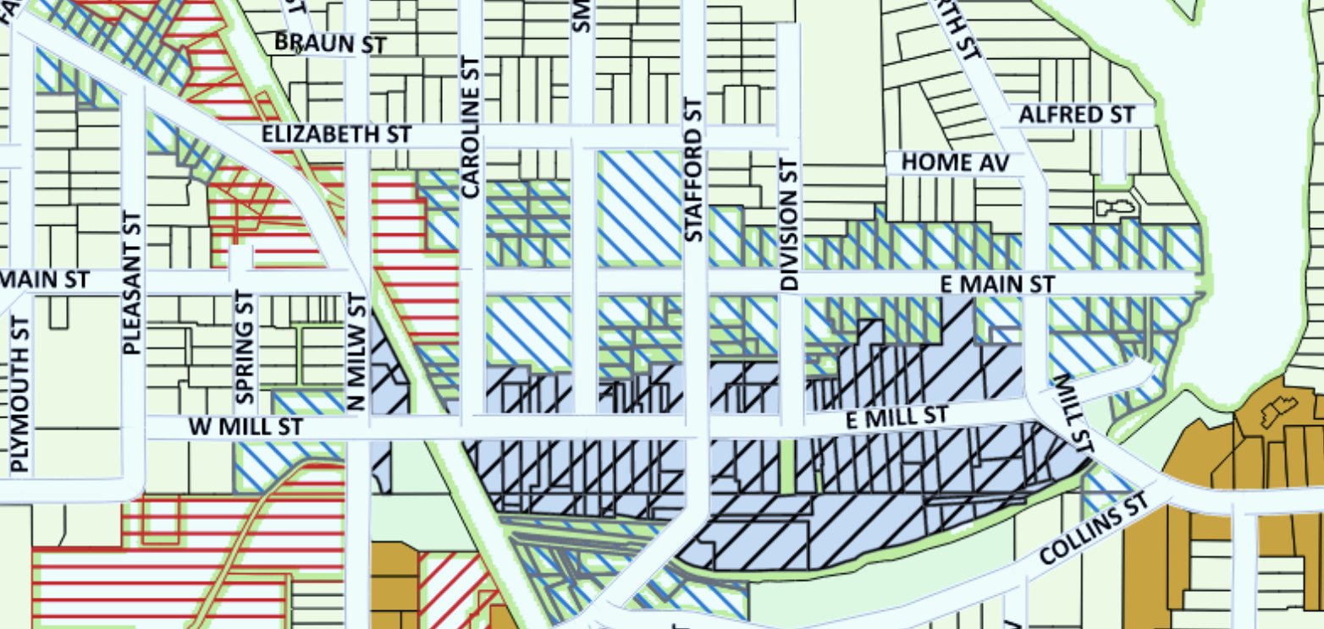
09
/
SITE – PLYMOUTH ZONING MAP
1

Slide 30
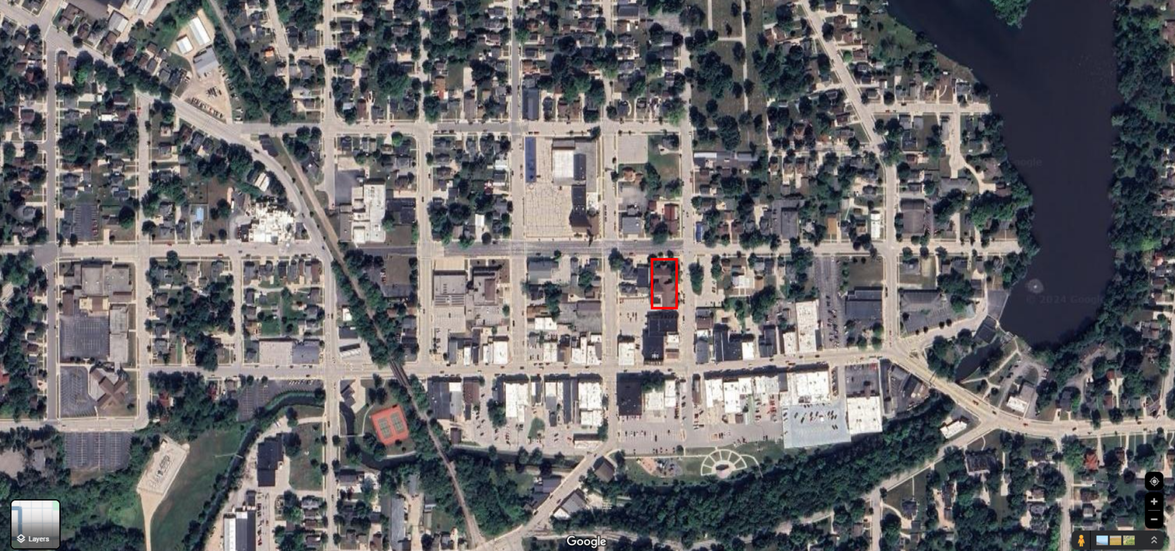
09
/
SITE – PLYMOUTH DOWNTOWN
1

Slide 31
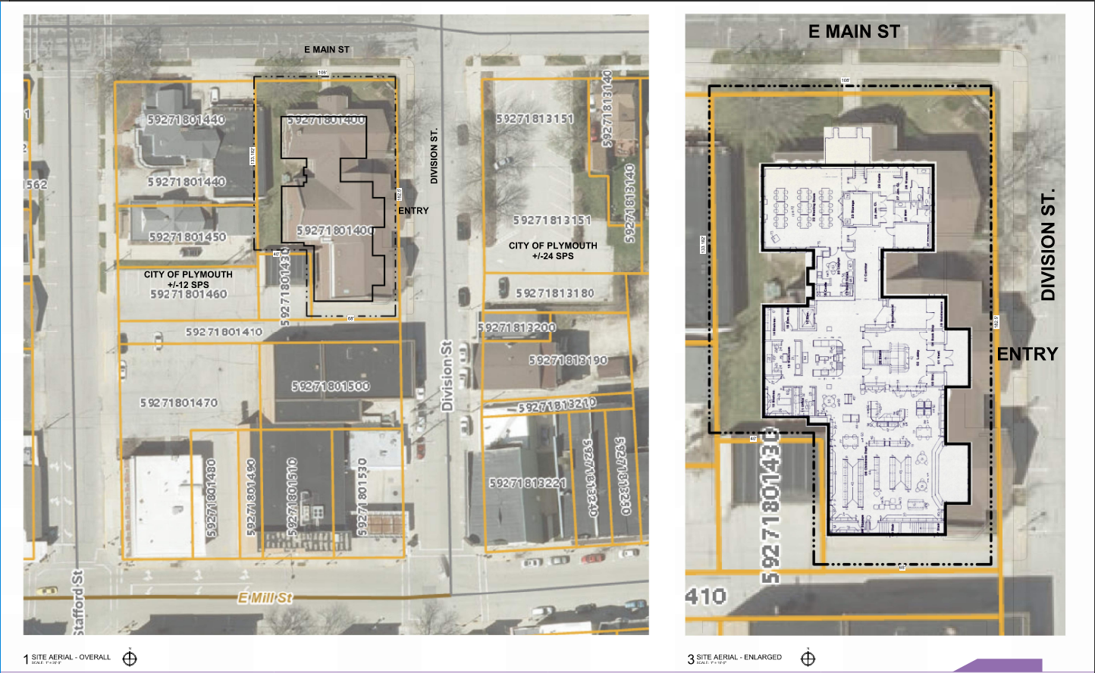
09
/
SITE – AERIAL MAPS
1

Slide 32
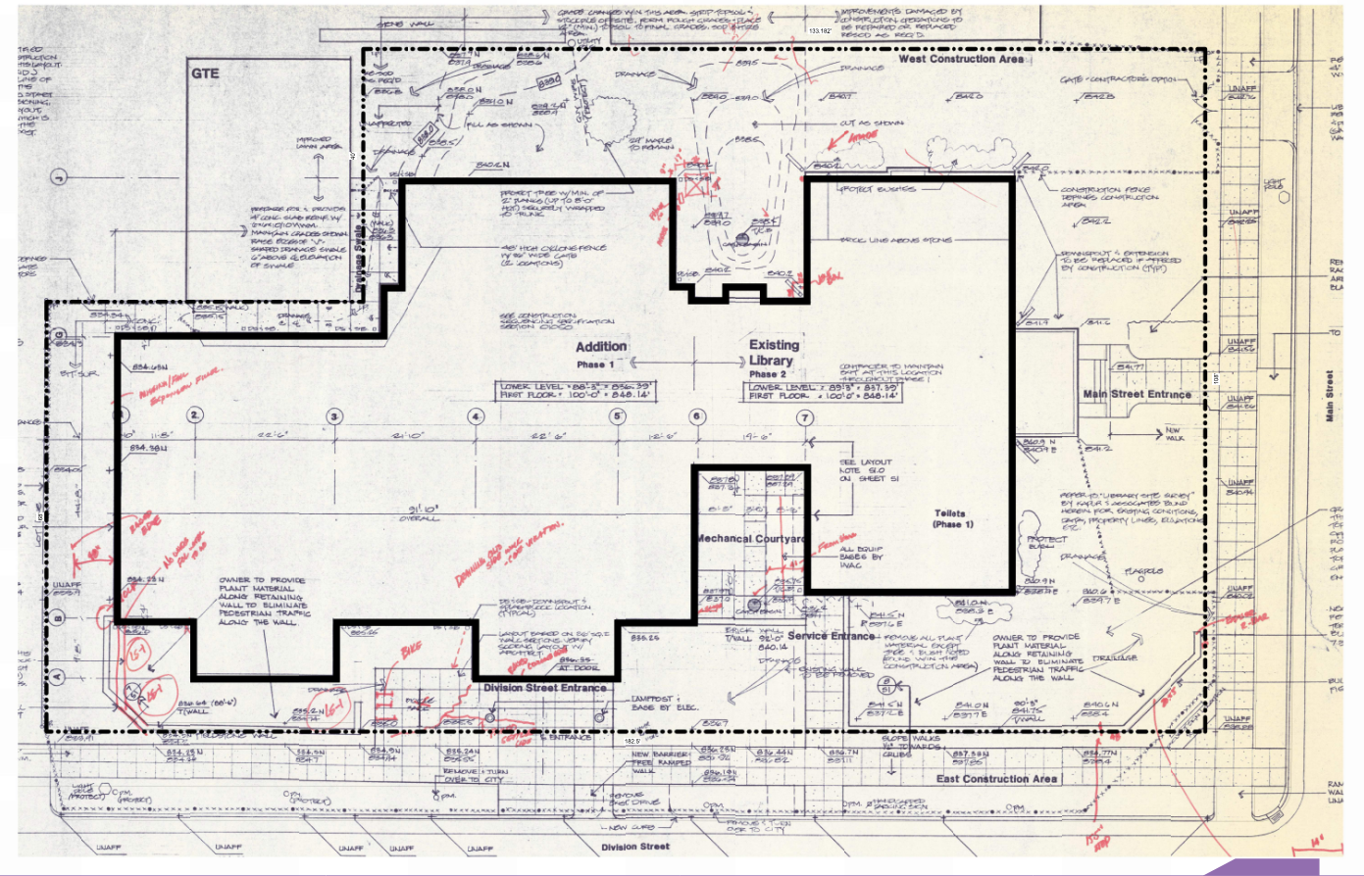
09
09
/
/
SITE OPTIONS
SITE - EXISTING

Slide 33
09
/
EXISTING PLANS

Slide 34
09
/
EXISTING PLANS

Slide 35
09
/
EXISTING ELEVATIONS

Slide 36
10
/
REVIEW SCHEDULE & TIMELINE

Slide 37
?
?
?
?
Questions or ideas you would like to see studied?

Slide 38
Next Meeting:
Wednesday April 17, 2024
@ 6:30 PM
THANK
YOU

